Slide 1
Building Aggregates with a Neighbourhood kernel and a spatial Yardstick (BANKSY)
Vipul Singhal
Spatial and Single Cell Systems Domain
A*STAR Genome Institute of Singapore
14 April 2022
Notes:
Good morning. I am Vipul Singhal, a postdoc at the genome institute of Singapore. I am here to tell you about a highly accurate and scalable spatial clustering algorithm we have developed called BANKSY.

Slide 2
Two major problems in spatial omics: cell-type clustering and domain segmentation
Cell Types
Characteristic
transcriptome
set of neighbours
Spatial Domains
Characteristic
cell type composition
Notes:
In spatial omics, there are two major types of labeling problems: cell typing and spatial domain segmentation.
Cell types are characterized by their transcriptomes and their set of neighbours.
Spatial domains are characterized by their cell type composition.

Slide 3
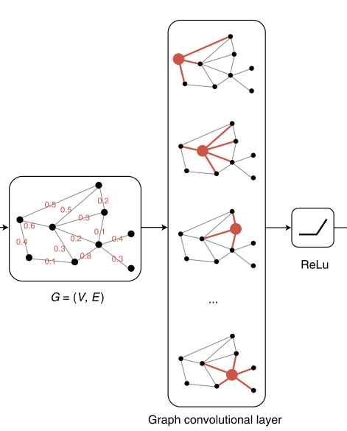
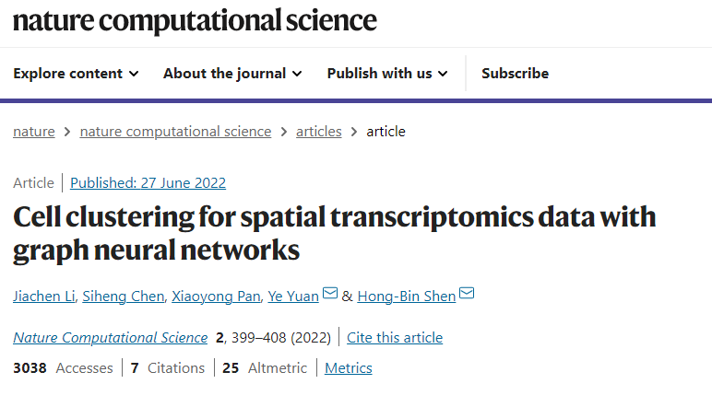
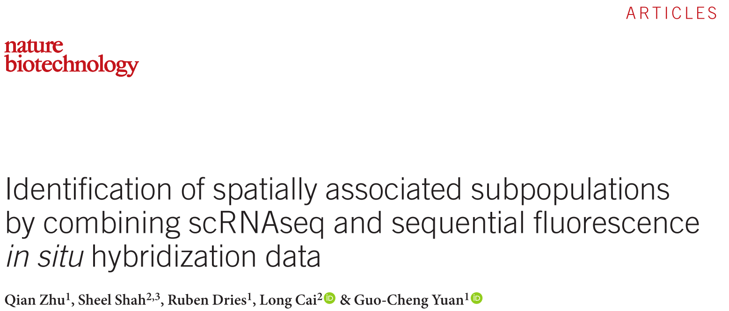
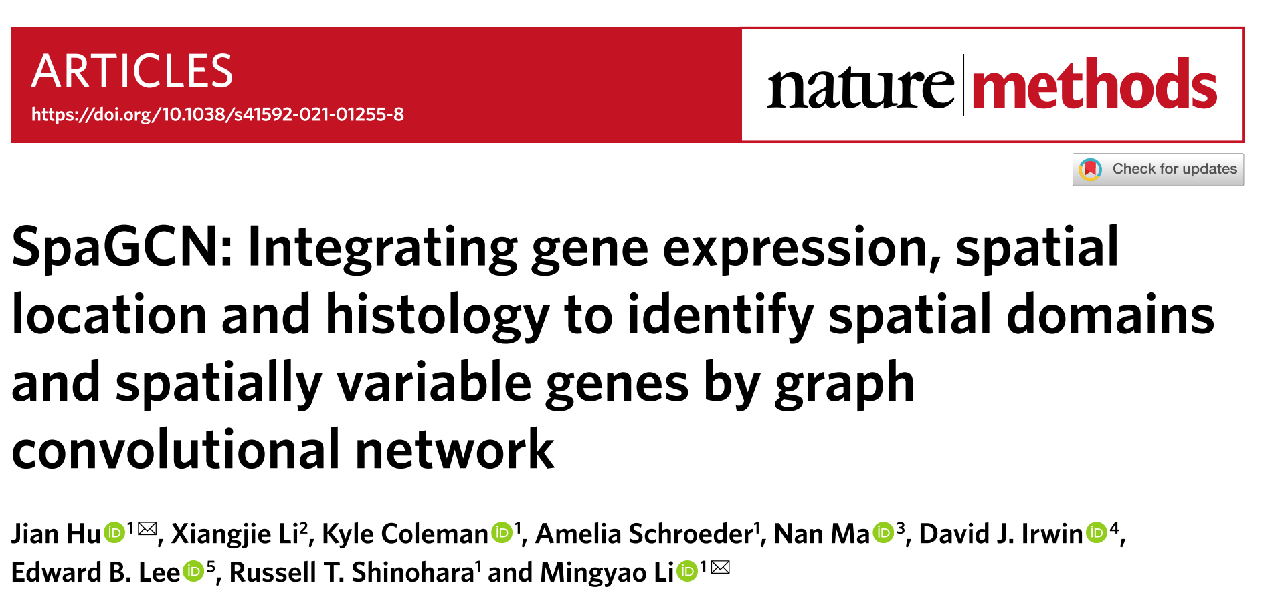
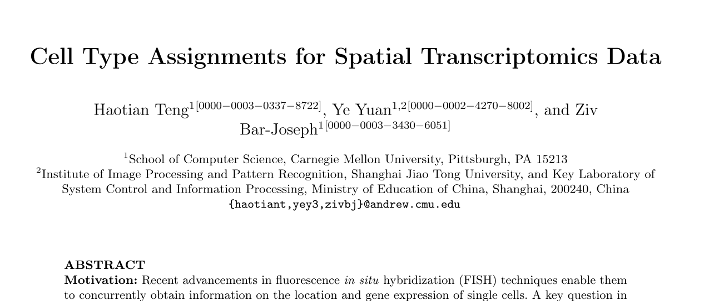
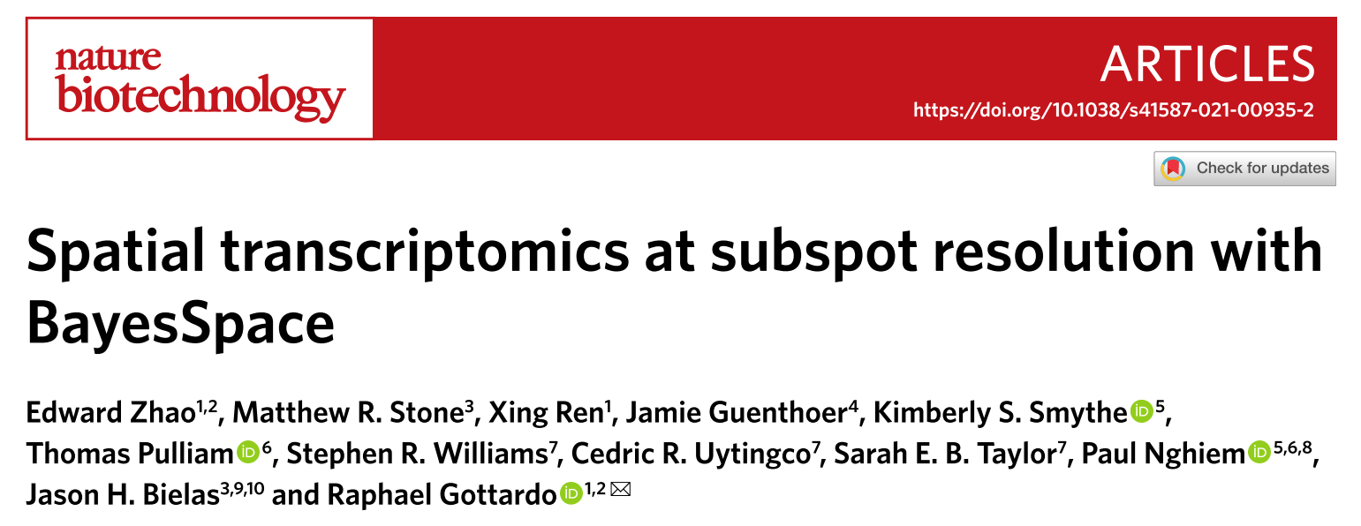
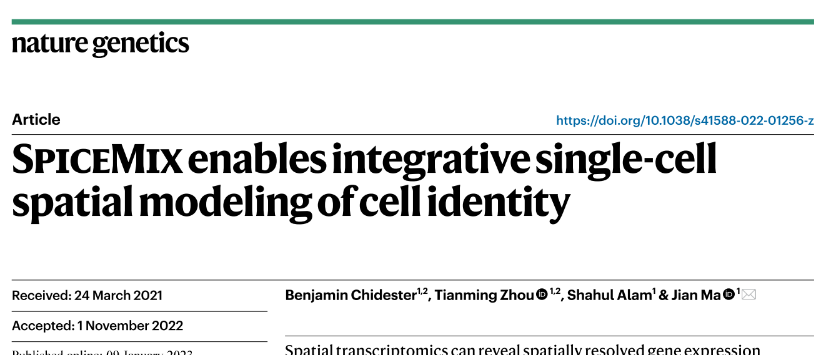
There are two main approaches to either problem
Probabilistic graphical models (Hidden Markov Random Fields)
Graph Networks / Deep learning
Hu et. al.
— Also unable to scale
— Large number of parameters, could overfit the data.
— Slow and unable to scale
Notes:
Given these two types of problems, there are..
- Two main approaches to solving either problem: HMRF based methods, and deep learning based methods.
- HMRF is basically a method where the probability of a cell being in a certain state is influenced by the states of its neighbouring cells.
Some HMRF based methods assume that a cell is identical to its neighbours, which is not always true.
If we make more realistic assumptions, then the method becomes complex and harder to train.
- deep learning models also struggle to scale to large datasets, and have a large number of parameters that could overfit the data.
All in all, this is a new field, and then methods have not been thoroughly benchmarked, possibly due to the model complexity.

Slide 4
BANKSY uses a feature augmentation approach for combining expression and spatial information
A cell has a characteristic transcriptome and a characteristic neighbourhood.
Notes:
So far I have told you about two general classes of methods for combining spatial and expression information. BANKSY at its core takes a fundamentally different approach, one that involves feature augmentation.
Here, we take each cell’s own transcriptome, and the average transcriptome of its neighbours, and concatenate them using a weighting parameter (which we call lambda) to get an augmented feature matrix.
Each column is a cell, and cell cell is represented by its own transcriptome and its average neighbourhood transcriptome
Once you have done feature aug, clustering can be done with any method. For scalability, we use graph based clustering methods as our default, but any method may be used.
The lambda parameter controls the influence of the neighbourhood transcriptome:
— when lambda is 0, just clustering by own expression, as we do in conventional single cell clustering.
— when lambda is 1, you are clusteirng exclusively by the average properties of the neighbourhood.

Slide 5
BANKSY also adds a third layer, which is the gradient of gene expression (using the azimuthal Gabor filter)
Notes:
In its actual implementation, BANKSY also adds a third layer, which captures gradients of gene expression in the neighborhood. It uses azimuthal Gabor filters, which are inspired by plane wave Gabor filters used in image processing, to capture an orientation invariant representation of gradients in the neighbourhood.

Slide 6
Benefits of adding neighbourhood features
Notes:
There are several benefits of adding neighbourhood features. One is cell type denoising of ambiguous labels.
For example, the region near the boundary between the two cell types is an ambiguous zone, and it is difficult to tell if the cell is from the blue or green cell type. When you take neighbourhood information into account, it becomes very clear which cell is from where.
Take home: nbd features help to distinguish related cell types.

Slide 7
Before testing BANKSY on real data, we first generated simulated benchmark datasets, where ground truth is available
Cell Types
7
Spatial Domains
Notes:
Now that we have seen what the algorithm is, we will look at how BANKSY performs. Before looking at real biological data, let’s have a look at simulated data, where we have the advantage of having the ground truth cluster labels.
The dataset shown on the top right here was generated by fitting a probabilistic model to the STARmap mouse visual cortex dataset (which is one of the datasets used for benchmarking in this field), and then generating cell of each type along with their transcriptomes. We also modeled the spatial distribution of the cells into domains, and distributed the cell types in proportions observed in the real data.

Slide 8
BANKSY outperforms competing methods in cell typing in simulated benchmarks, where ground truth is available
Notes:
First we look at cell typing, where BANKSY achieves a higher accuracy than all other tested methods.
Here, we tested the accuracy of five methods at varying numbers of measured genes, and found that BANKSY achieved a higher accuracy in all tested conditions.

Slide 9
BANKSY outperforms competing methods in spatial domain identification in simulated benchmarks as well
Notes:
We saw that BANKSY does better than competing methods in cell typing. We find that a similar situation holds for domain segmentation, where once again, BANKSY outperforms all competing methods.
However, simulated data, regardless of how realistic we try to make it, is ultimately not representative of the complexity in real data. Thus, we next show how BANKSY performs on real data.

Slide 10
BANKSY: cell-type and subtype clustering
Notes:
In the next part of the talk, we will apply BANKSY to various real datasets from a diverse set of spatial omics technologies. In general, there are both qualitative and quantitative testing strategies we can explore.
One qualitative strategy is to show that BANKSY discovers biological cell types and subtypes that nonspatial and other methods fail to discover. We will discuss this next.
Another qualitative strategy is to show that BANKSY outperforms nonsptial methods by making effective use of spatial information.
Finally, the quantitative approach involves quantifying the performance of competing spatial algorithms at recapitulating a set of externally defined class labels
—
We begin with identifying cell types and subtypes that cannot be identified by nonspatial or other spatial methods.

Slide 11
BANKSY leverages the neighbourhood transcriptomes to identify subtly different neuronal subtypes
Notes:
As a first test, we tried BANKSY on a mouse brain VeraFISH dataset. This is a single cell resolution in situ hybridization method, much like the MERFISH and SeqFISH methodologies.
Here, we found that BANKSY leveraged differences in neurons neighbourhoods to distinguish neurons in the somatosensory cortex and the CA3 region of the hippocampus. These two subgroups were marked by the differential expression of a handful of genes.

Slide 12
We corroborated the neuronal subtypes from those found in annotated scRNA-seq data from the literature
Notes:
To verify that these neuronal subtypes could be corroborated with single cell RNA sequencing data, we clustered the single cell data from the literature using the DE genes between the two subclusters, and their most highly correlated genes in the single cell dataset (these are called the guilt by association genes). We found that using the genes we identified in the Spatial data, we were able to exactly recapitulate the cluster separation between the CA3 hippocampal neurons and the CA3 neurons in the single cell RNA Seq data.

Slide 13
Beyond nonspatial clustering: other tested method were unable to robustly identify these subtypes too
Notes:
We have looked at how nonspatial clustering is unable to separate the neuronal subtypes between the CA3 and somatosensory cortex. Now we see that a host of other methods from the literature struggle to achieve the same.
While Giotto does identify the two cells subtypes, it does have other problems (not shown here, but you can ask me about that if you would like).

Slide 14
Notes:
add oligo slides, and the GO term verification.

Slide 15
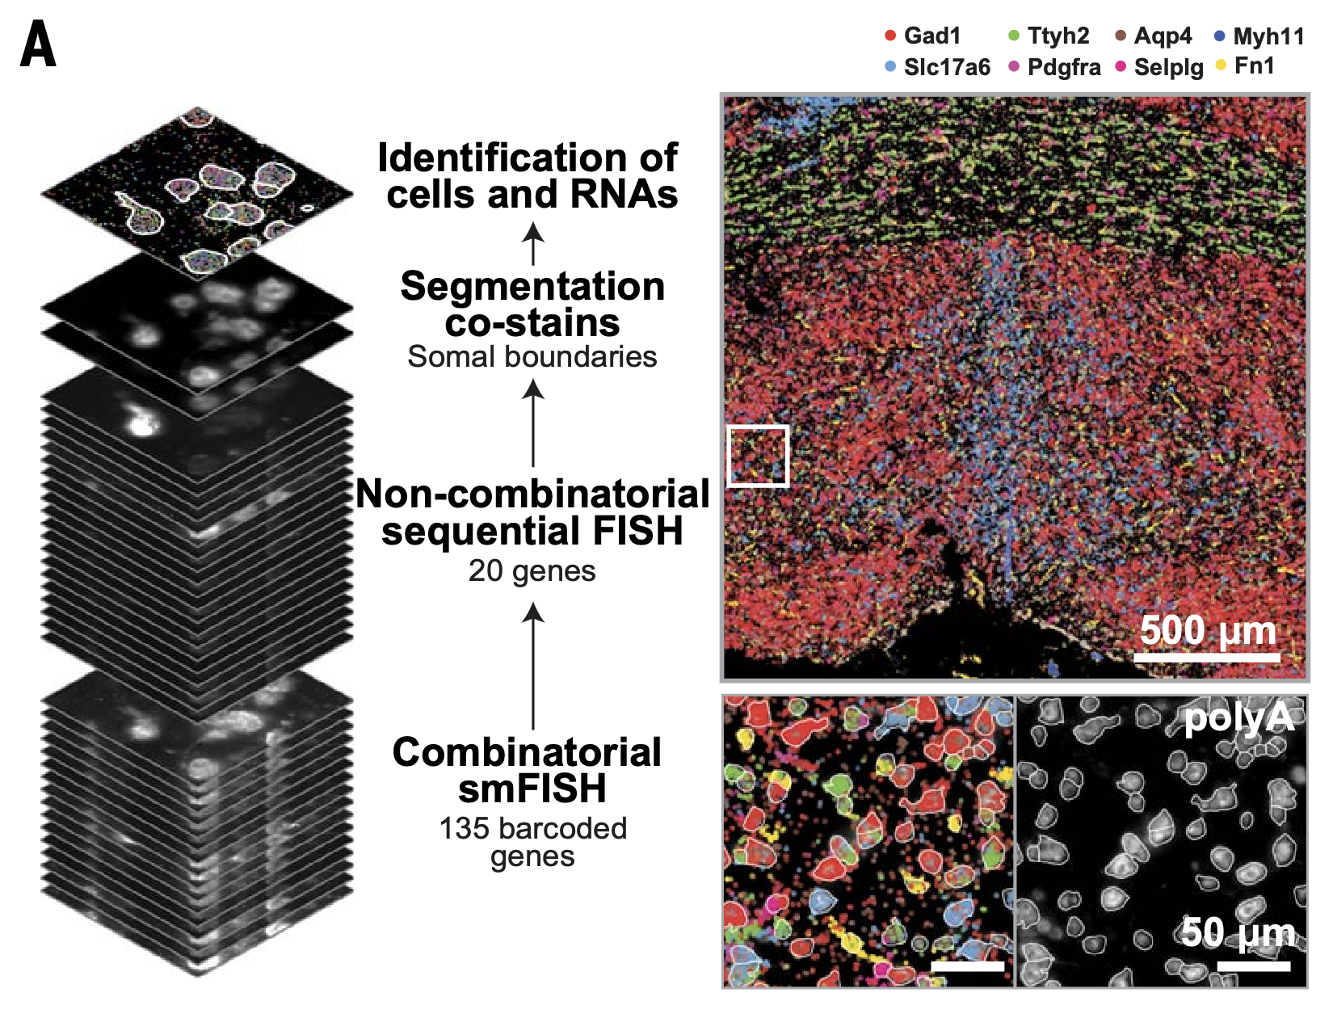
BANKSY helps distinguish subtly different subgroups within the mature oligodendrocyte population
Moffitt et al. 2018
Notes:
As a second example of a situation where spaital information is needed to identify spatially separate subtypes, we look at the mouse hypothalamus MERFISH dataset coming out of Xiaowei Zhuang’s lab.
Here, again, we found that we were able to use the neighbourhood information to stratify a cell type, in this case the oligodendrocytes, into an anterior commissure population and a general hypothalamus population.

Slide 16
Neighbour information helps distinguish subtly different cell types
Notes:
Here, we gain some insight into how BANKSY separates these subtly different subtypes. The heatmap shows:
— red and orange cell types, and own and neighborhood transcriptomes. We see that even though the own expression is only subtly different, the neighbourhood transcriptomes are very different, and this is what is being leveraged by BANKSY.
— this can be visualized a different way: a metagene plot constructed out of the own and neighbourhood expressions of the average expression of the DE genes between the two subclusters. We see that… (overlap, better separation).
Finally, like we corroborated the neuronal subclusters in the VeraFISH data in scRNASeq data, we used the MERFISH DE genes to cluster matched scRNAseq data, and found that we were able to separate that into subclusters that matched the two oligodendrocyte populations.

Slide 17
Notes:
add the GO term verification.

Slide 18
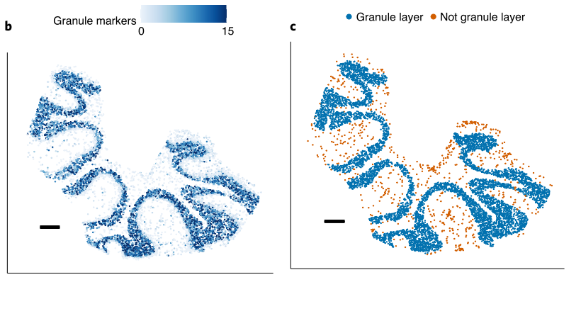
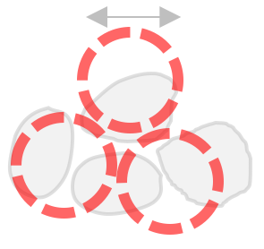
BANKSY is general enough to work with methods that are not single cell resolution, such as SlideSeq
Each measured “spot” has 1 to 2 dominant cell-types, along with further contamination from surrounding cells
RCTD: Cable et al. 2021
Notes:
The real power of elementary methods is that they can be applied to any data type, even sequencing based technologies like SlideSeq. Does not have to be true single cell resolution.
People have suggested that we need deconvolution methods. we asked the qs: is babksy general enough to handle the labeling of slide seq data.
advantage: you dont need external datasets,.
BANKSY is not a MERFISH algorithm. its a general algorithm.
. Multiple cells can contaminate the measured ‘spots’, leading to misclassification
Slide seq is inherently noisy. clustering is harder for slide seq data.
RCTD: supervised method that makes use of the reference cell type.
RCTD: uses extrernal information – uses a database of granule cell treanscriptomes and other transcriptomes to deconvolve. The problem is this puts the onus on the user to provide prior knowledge , and this might not always be available.
We asked whether if BANSKY could do unsupervised clustering and still get the correct result. without prior knowlecge.
depends on the availability of reference datasets (which might not be available) so also want an unsupervised approach that works.

Slide 19
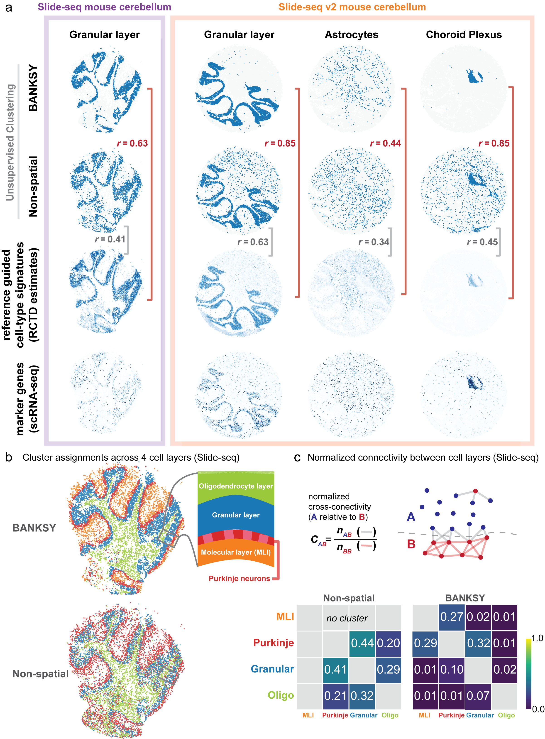
BANKSY improves clustering accuracy without requiring external reference data
Notes:
———
BANSKY emulated the performance of the supervised methods without requiring the reference data.
animate the other cols after the first columns.
For interneurons, BANKSY even outperforms even the supervised methods.
I hope I have convinces you that BANKSY is a very general purpose methods that can be applied to a diverse set of data types.

Slide 20
BANKSY: spatial domain segmentation accuracy
Notes:
We then tested BANKSY’s performance in segmenting spatial domains.

Slide 21
10x Visium human DLPFC benchmark: BANKSY outperforms competing algorithms in accuracy and consistency
Notes:
We start with a classic benchmark that many algos have used. tissue domains are manually annotated by experts. You have a ground truth that you can use to verify algos.
idea is to call layers in the mouse brain.
Banksy has the highest accuracy and the most consistent results (IQR is very small) . other methods: lower on average and highly variable.
——
In order to benchmark performance, we need a well-labeled dataset.
10X visium, like slide-seq is a sequencing based spatial technology, but has a much lower resolution.
This 10X Visium human dlpfc dataset has been used very often in the literateure to benchmark domain segmentation.
This dataset has manually curated labels, which is still quite rare in the field.
When we ran BANKSY, the accuracy on all 12 samples in the dataset was higher than that of competing methods.
In addition, BANKSY had a much more consistent accuracy over the 12 datasets, as shown by a smaller inter-quartile range.

Slide 22
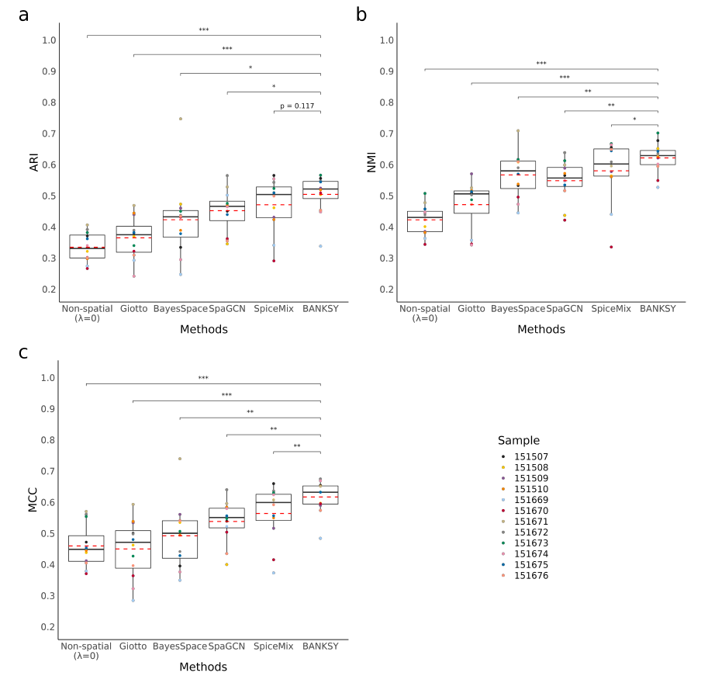
Benchmark by 3 metrics

Slide 23
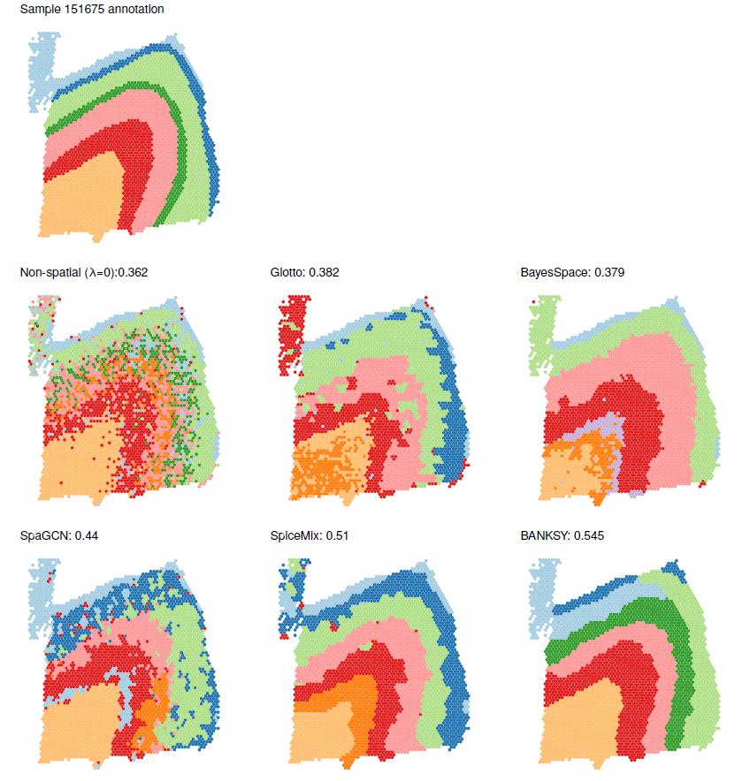
Qualitative comparison of 151675

Slide 24
STARmap annotations by SpaGCN

Slide 25
STARmap 1020 gene mouse visual cortex: BANKSY outperforms competing algorithms in domain-finding accuracy
Notes:
Again to show the generality of BANKSY, we show BANKSY on a different tech. single cell res.
( if someone asks: we do see systematic expression differences between the two regions. not clear if it is biological or a technical artefact. nevertheless, the purity of the regions is higher . )
———————-
As a second benchmark, we used the STARmap 1020 gene mouse visual cortex dataset.
Here we do not have manually curated domain annotations, but the domain boundaries can be seen by eye from the cell type labels.
So we were able identify the implied domain annotations and benchmark BANKSY on this dataset.
Again, BANSY outperformed all the other methods and produece more contiguous domain labels.

Slide 26
Mouse Hypothalamus MERFISH data: BANKSY finds domains matching Allen brain atlas annotations
This is the same dataset previously used to show novel oligodendrocyte sub-types
Pe: periventricular hypothalamic nucleus, BNST: bed nucleus of the stria terminalis, MPN: medial preoptic nucleus, MPA: medial preoptic area, PVA: paraventricular thalamic nucleus, PVH: paraventricular hypothalamic nucleus, Fx: fornix, 3V: third ventricle
Notes:
We ahve shown in sims that you can analyze the same dataset in two ways. here is an example of a dataset we have seen in the context of cell typing.
Next we ran BANKSY on the same mouse hypothalamus dataset where we showed oligodendrocyte cell types
By varying lambday and nothing else, we were able to detect spatial domians, many of which we could map to annotations in the Allen brain atlas
This shows that BANKSY can perform both cell typing and domain segmentation on the same dataset

Slide 27
Brain organoid MERFISH data: BANKSY domain-segmentation is useful for QC of spatial data
with Jinyue Liu
Notes:
Now I want to show you something completely different: unexpected bonus: instead of finding cell types as tissue domains, we can use it to do spatial QC.
BANKSY domain segmentation can be used as a QC tool to remove contiguous regions (necrotic domains, regions of low image quality etc.)
Heat shock proteins are significantly higher in cells near to core of organoid than in other cells
One other use of BANKSY’s domain segmentation mode is to perform QC on spatial data.
In this orgaoind data from Jinyue, she used BANKSY to identify a spatially localized cluster close to the core of the organoid that expressed high levels of heat shock proteins.
We could then remove cells from this cluster before performing futher analysis
Similarly, BANKSY could be used to identify whole regions with low image quality or which contain other quality issues.

Slide 28
BANKSY: speed and scalability
Notes:
Finally, a big benefit of BANKSY is its speed and scalability.

Slide 29
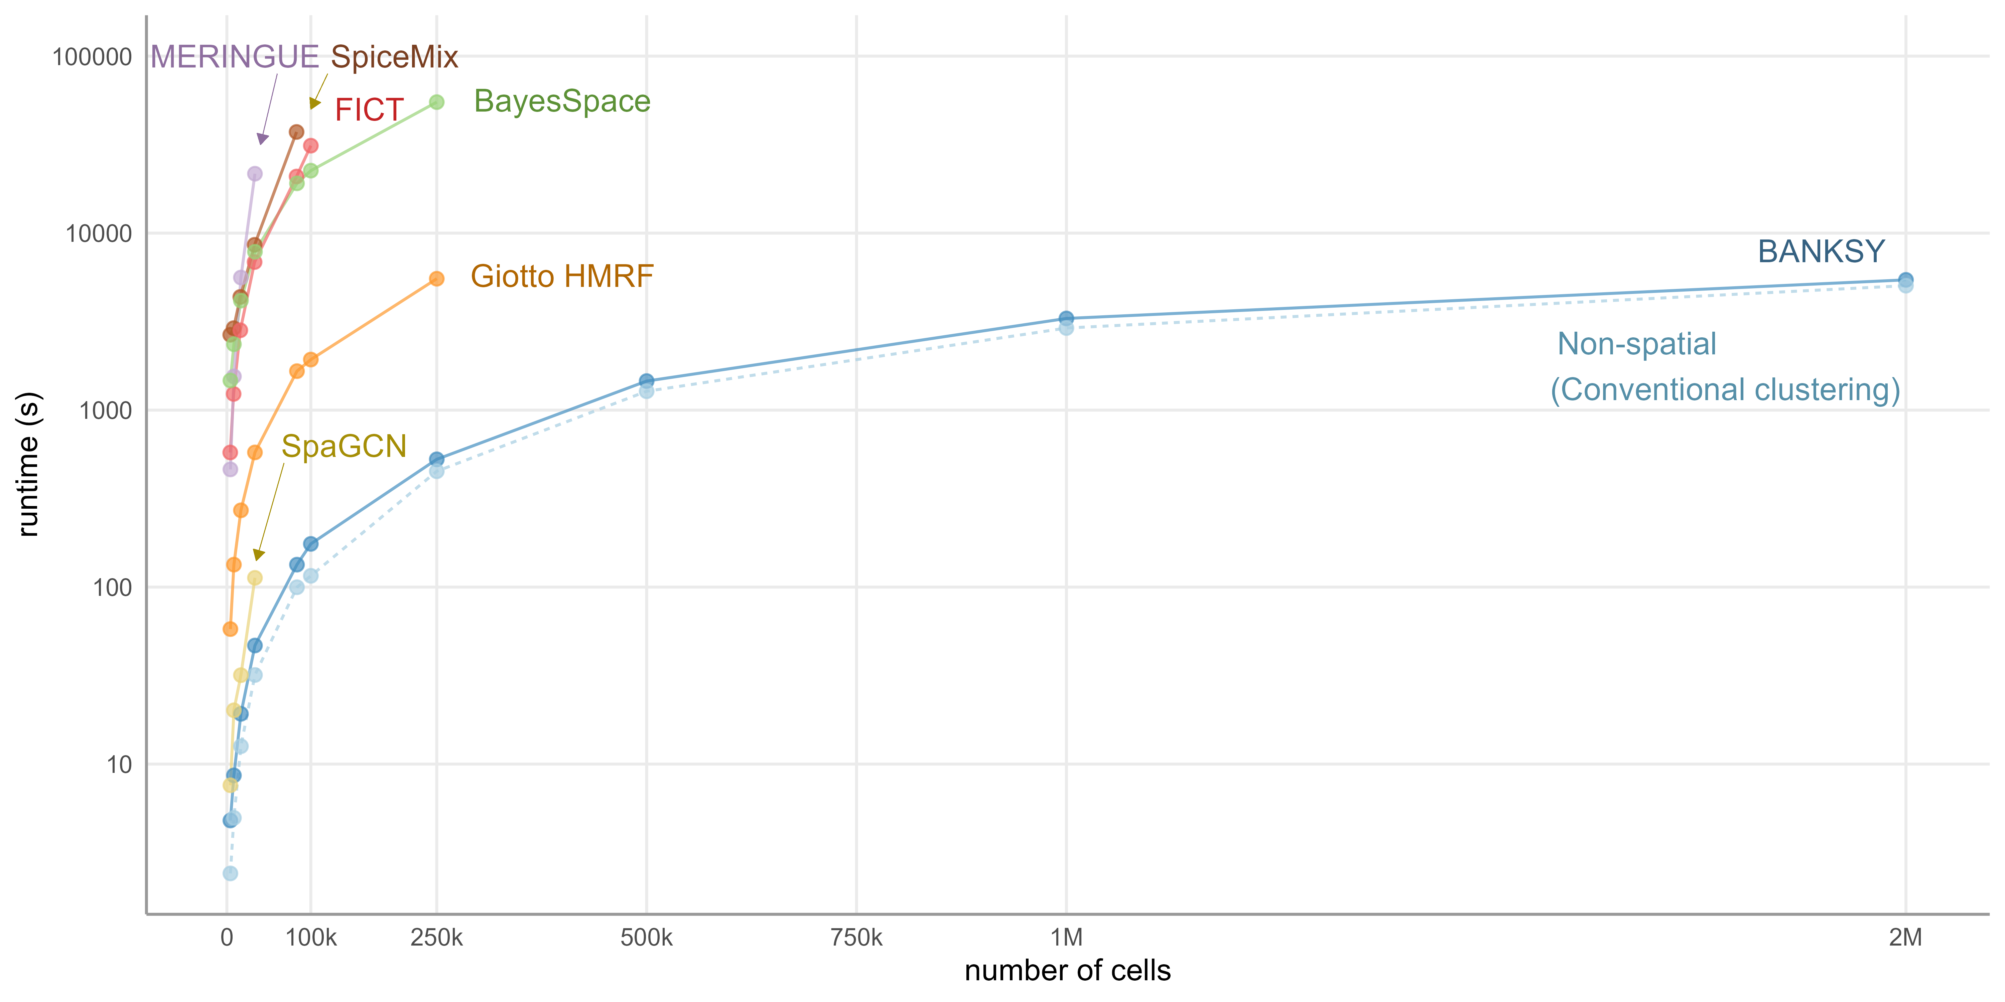
BANKSY is order(s) of magnitude faster and more scalable than competing methods
Notes:
BANKSY is much faster and more scalable than the competing methods, and in fact is almost as fast as non-spatial clustering.
The reason for this is that the embedding step, or the generation of the neighour augmented matrix is fast. So most of the time is taken by the subsequent clustering step. This step also scales linearly with the number of cells, which means that BANKSY is scalable to very large datasets.

Slide 30
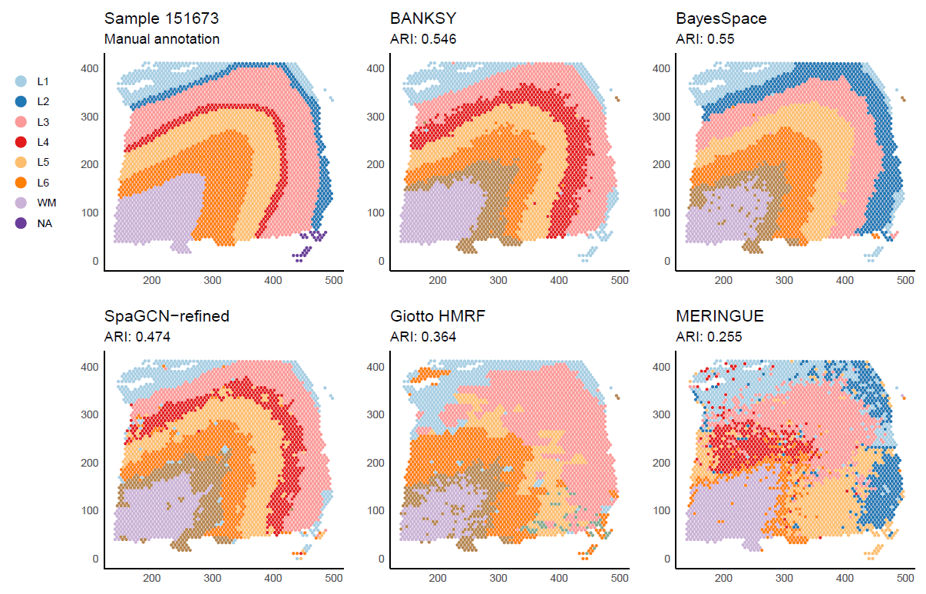
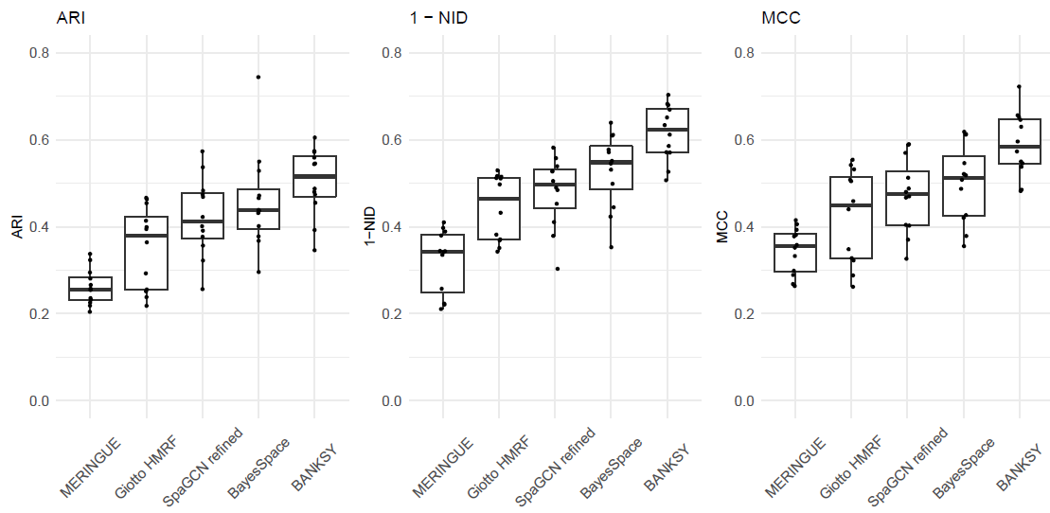
VISIUM benchmarking, using median over k_expr—res.

Slide 31
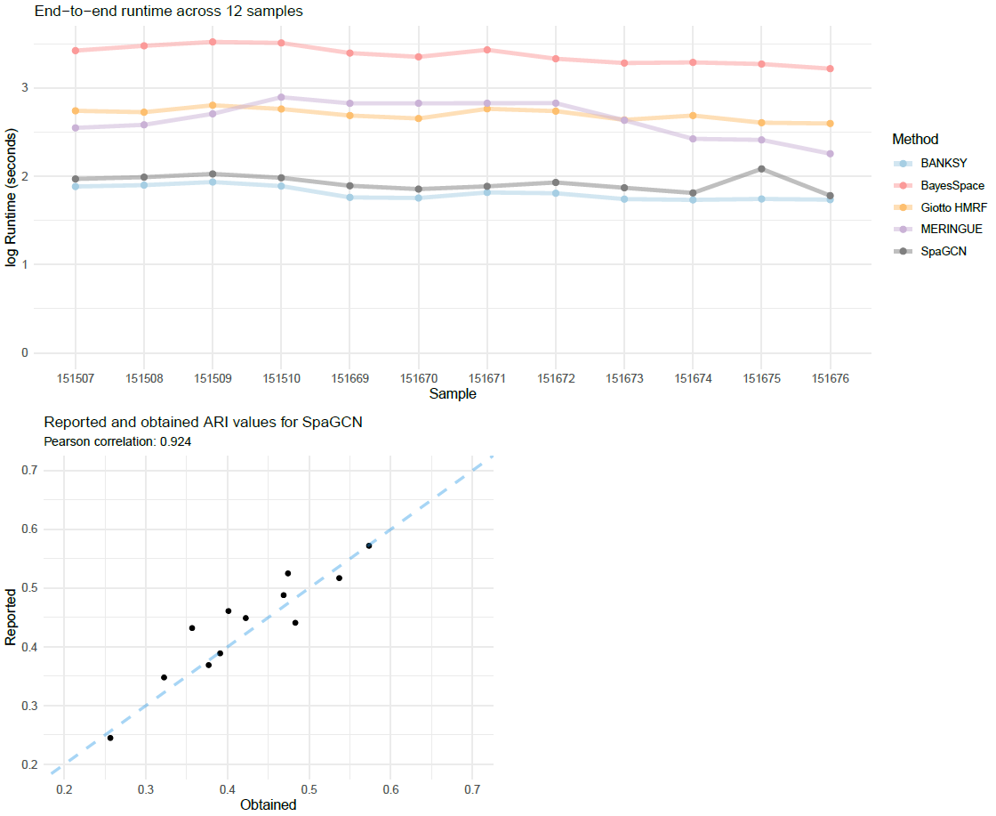

Slide 32
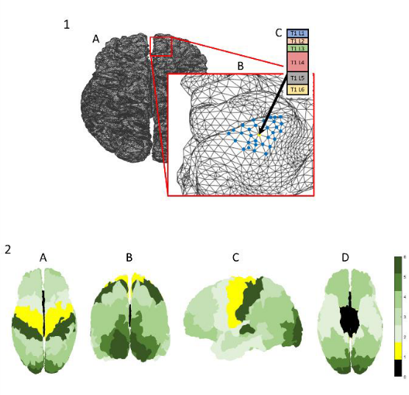
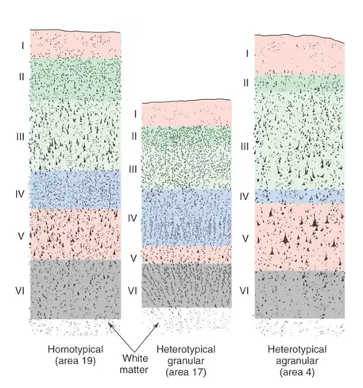
Beyond spatial omics: BANKSY identifies anatomical structures in the human brain from MRI data
Clustering laminar cytoarchitecture on the cortical surfaces
Ittai Shamir, Yaniv Assaf, Ron Shamir
bioRxiv 2022.10.29.514347; doi: https://doi.org/10.1101/2022.10.29.514347
nodes: positions on cortical surface
edges: spatial proximity on surface
features: layer thickness
Notes:
I ahve shown you in su=imulations and real data, that banksy out performs other algos in both cell typing and domain segmentation both qualitatively and quantitatively , and banksy identifies new biology.
this is all spatail transcriptomics.
we believe that banksy’s logic is truly general, and is applicable to fields beyond molecular biology.
We were very gratified to see that someone has applied banksy to MRI data.

Slide 33
BANKSY: novelty and significance
Unique biologically motivated feature augmentation strategy.
First algorithm to unify cell-type clustering and tissue domain segmentation
Broadly applicable: applies to any spatial omics data type
Top performer in systematic benchmarking
Most accurate cell type assignments
Most accurate domain segmentation
Can detect novel spatially restricted subtypes
Elementary, robust: only one additional free parameter
Orders of magnitude faster and more scalable than many existing approaches

Slide 34
BANKSY summary: “a cell is known by the company it keeps”
biologically intuitive and interpretable framework for both cell-type clustering and domain segmentation.
outperforms competing methods in accuracy on multiple benchmarks (simulated and real)
10-1000 times faster and more scalable than methods tested
Future work:
Neighbour-augmented matrix could be used for purposes other than clustering: batch-correction, data integration, cell-cell interactions etc.
Graph convolutional networks: don’t perform as well as BANKSY for unsupervised clustering, but may work well on labeled data. Feature-augmentation idea and intuition can be applied

Slide 35
Acknowledgements
Acknowledgements:
Nigel Chou (GIS)
Joseph Lee (NUS)
Shyam Prabhakar (GIS)
Kok Hao Chen (GIS)
Jinyue Liu (GIS)
Jonathan Aow (GIS)
Hwee Kuan Lee (BII)
Erica Teo (Veranome)
Yun Ching Chang (Veranome)
Funding: A*STAR
Nigel Chou
Joseph Lee
Lee Hwee Kuan
Shyam Prabhakar
Chen Kok Hao
23
Notes:
github page, biorxiv, — put them in a few diff places in the slides.

Slide 36
Questions

Slide 44
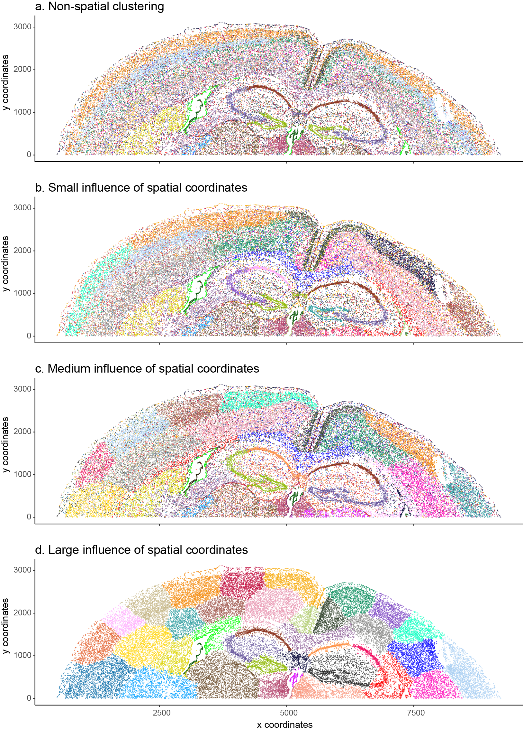

Slide 47
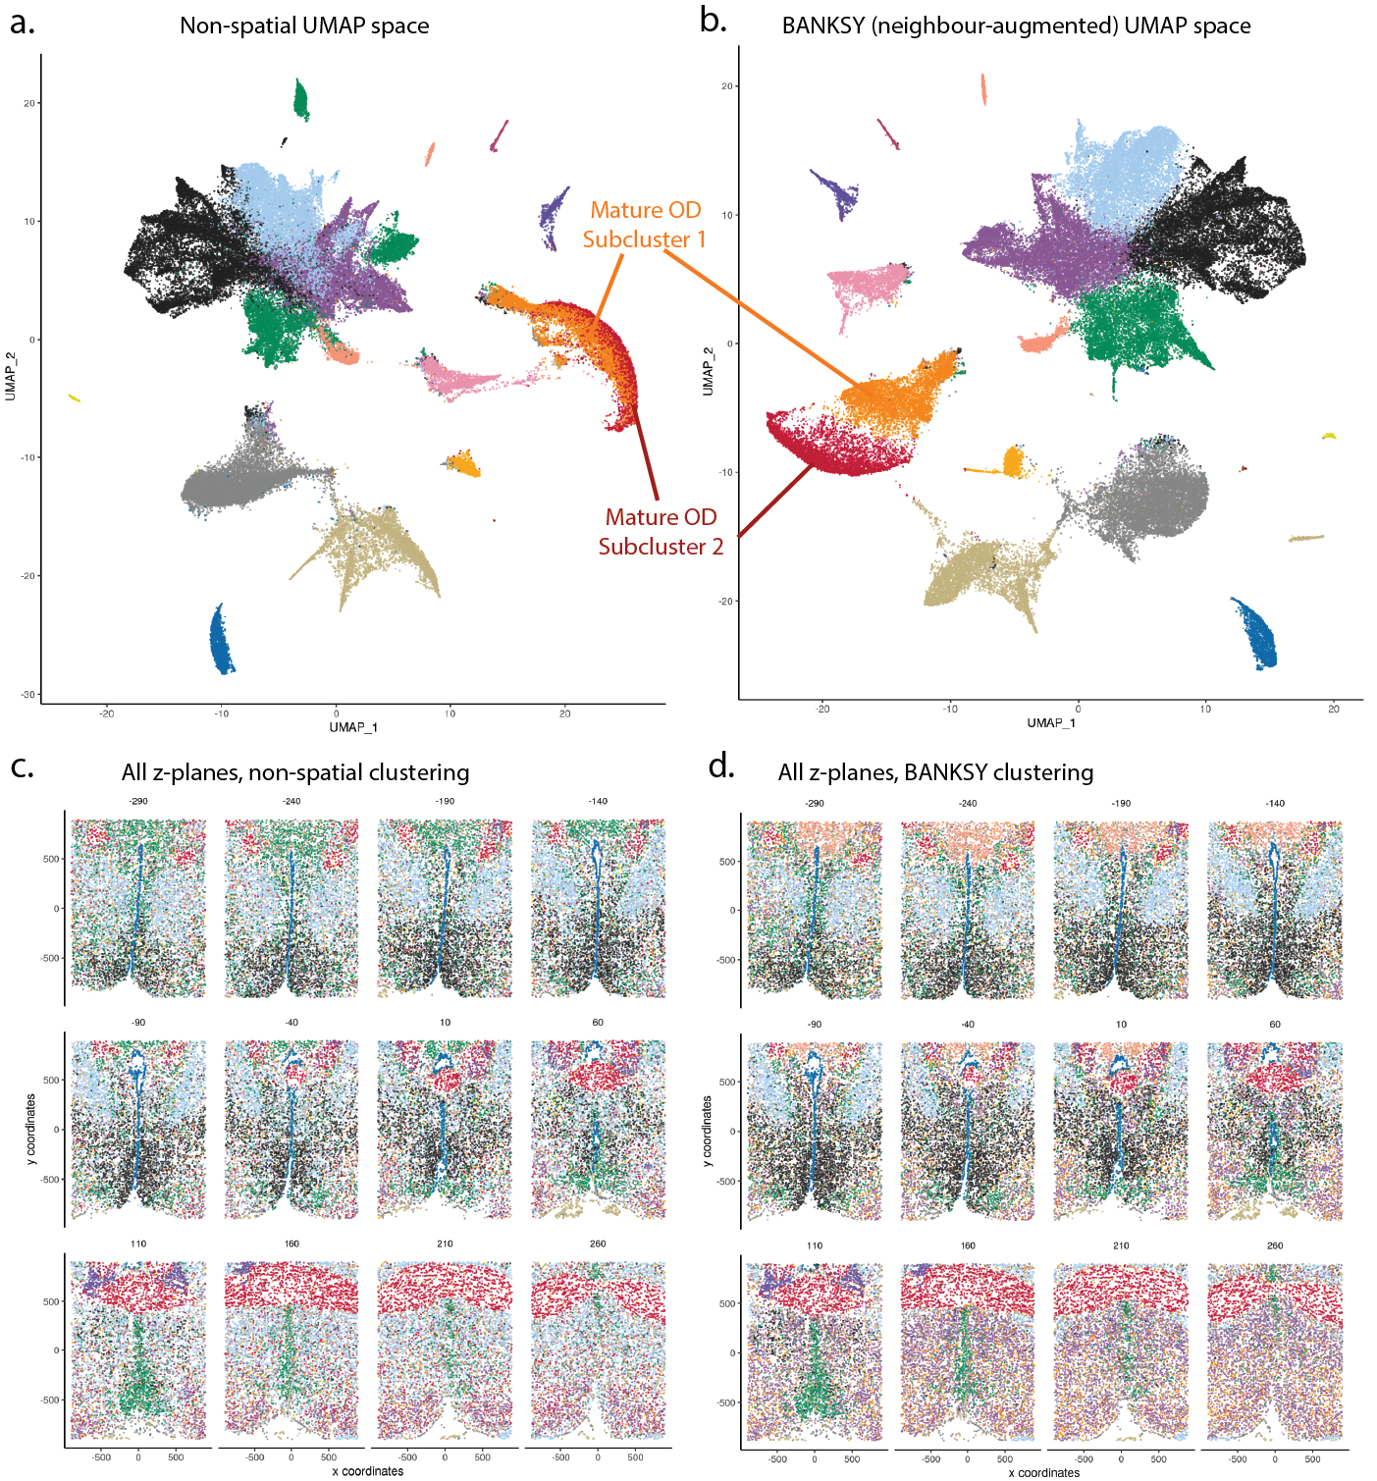

Slide 48
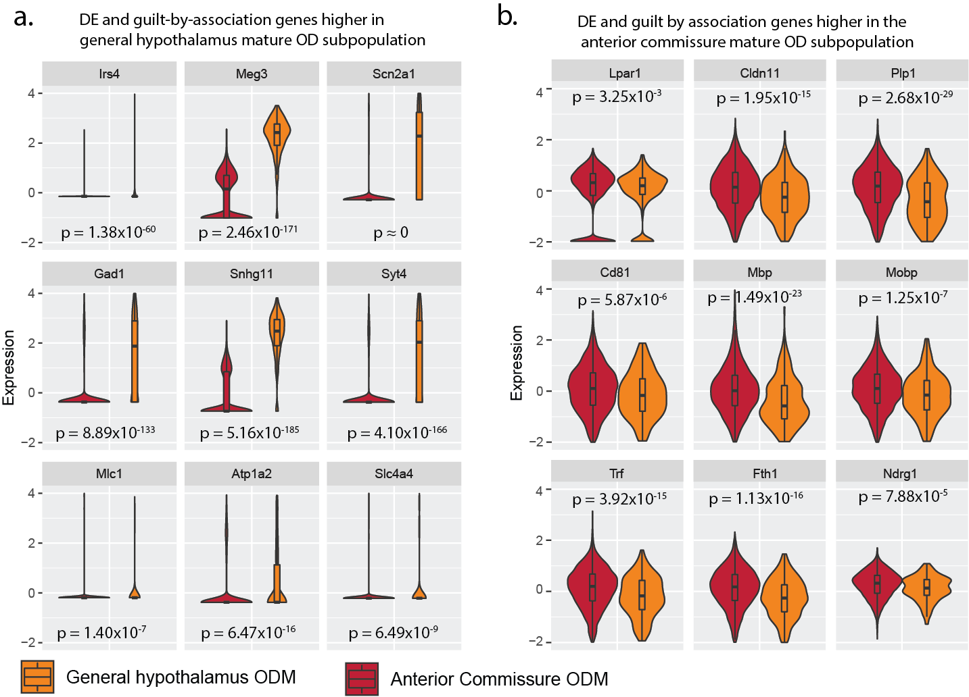

Slide 49
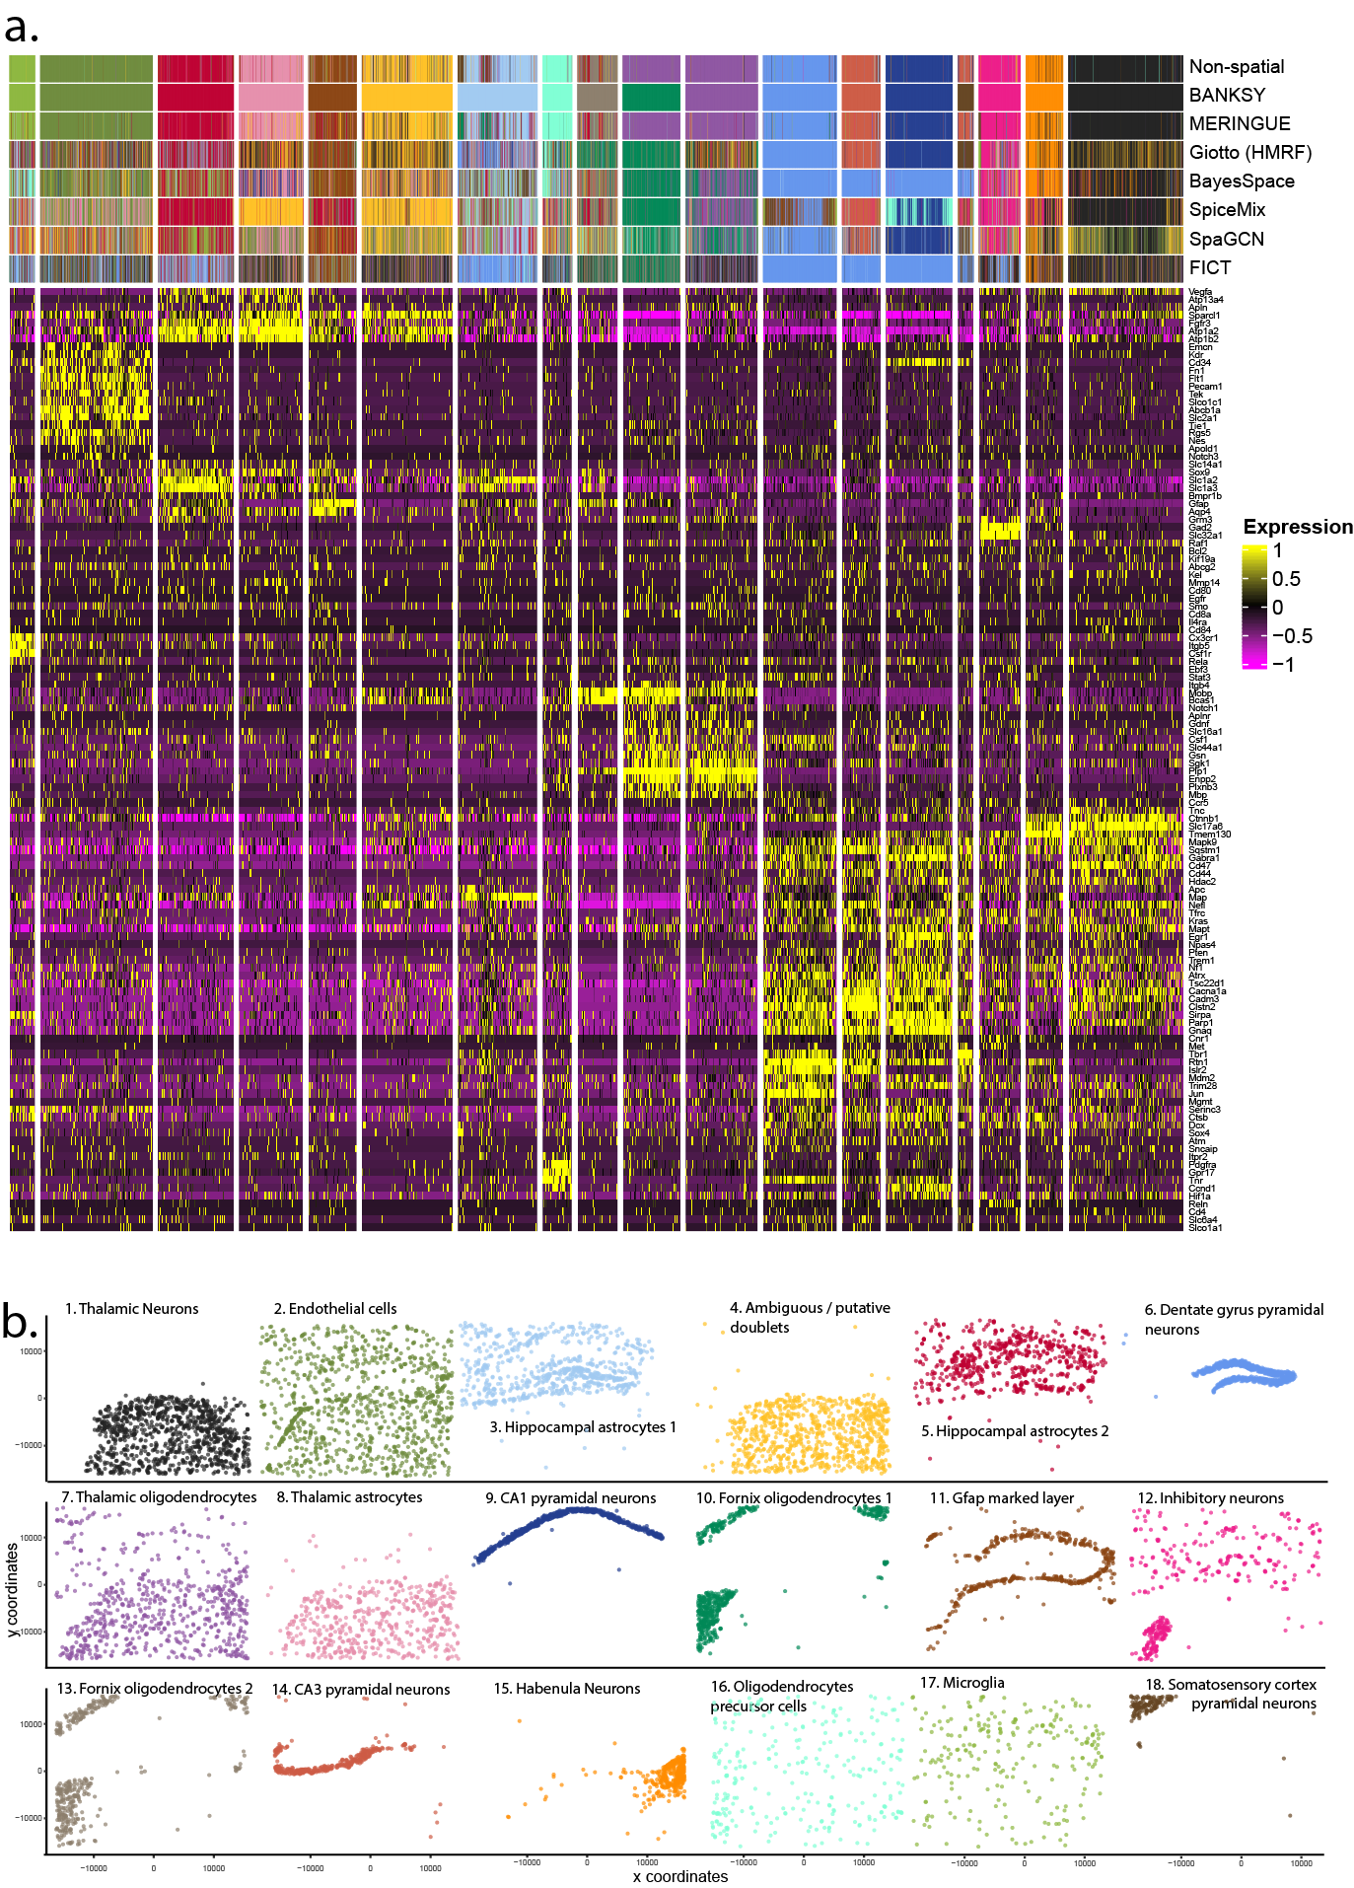
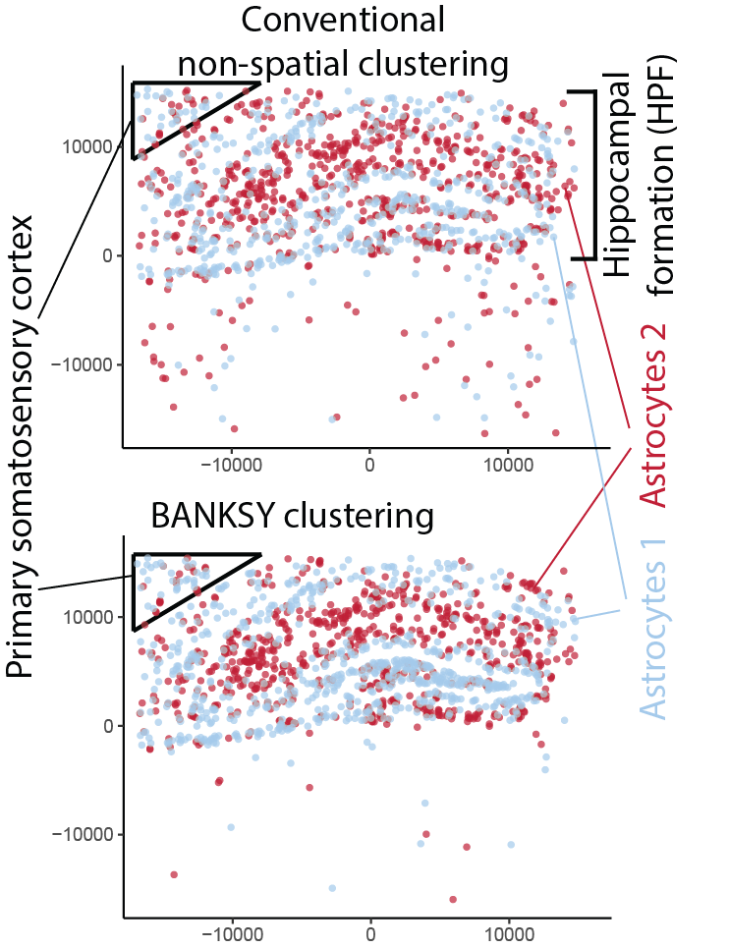

Slide 51
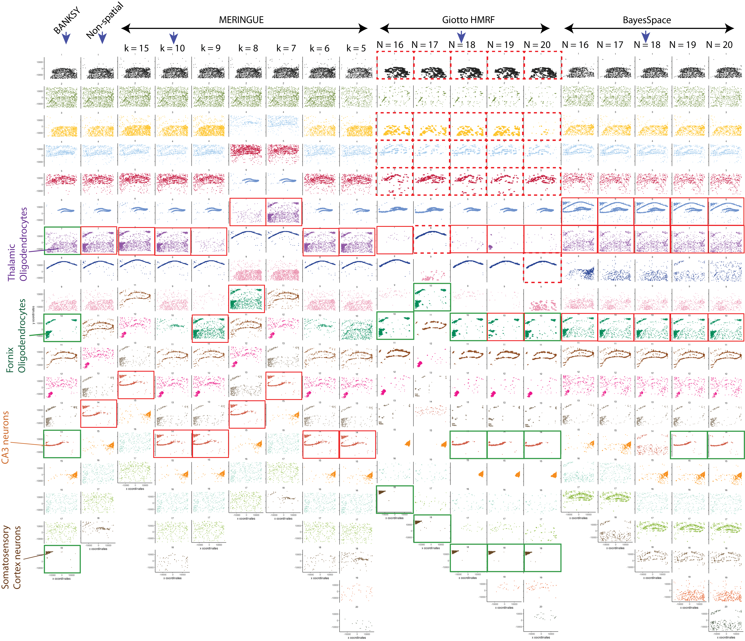

Slide 52
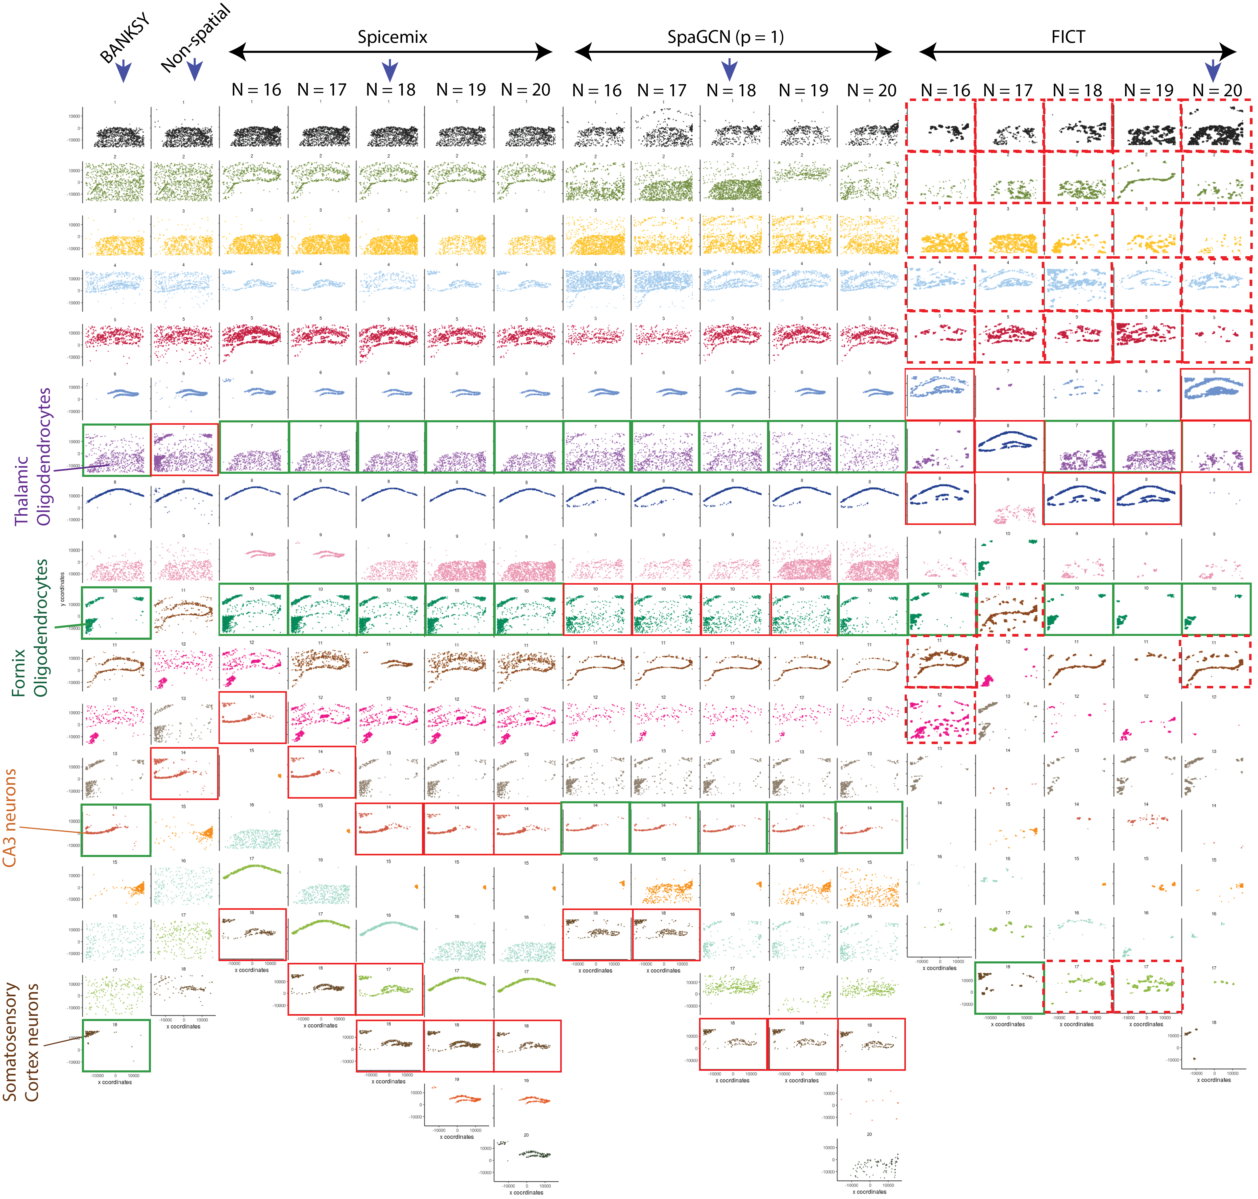

Slide 53
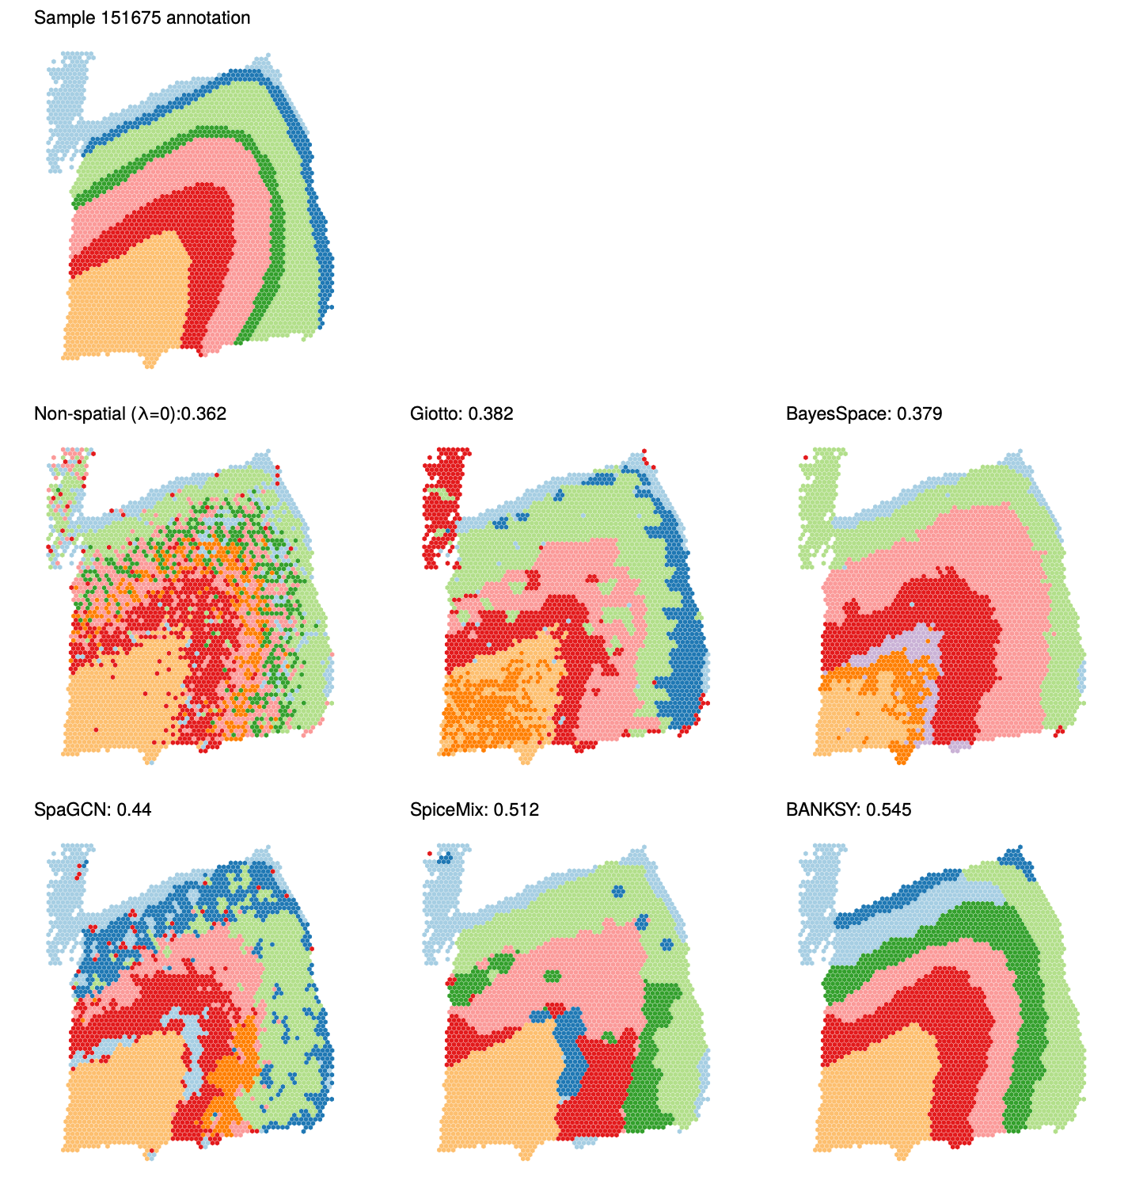
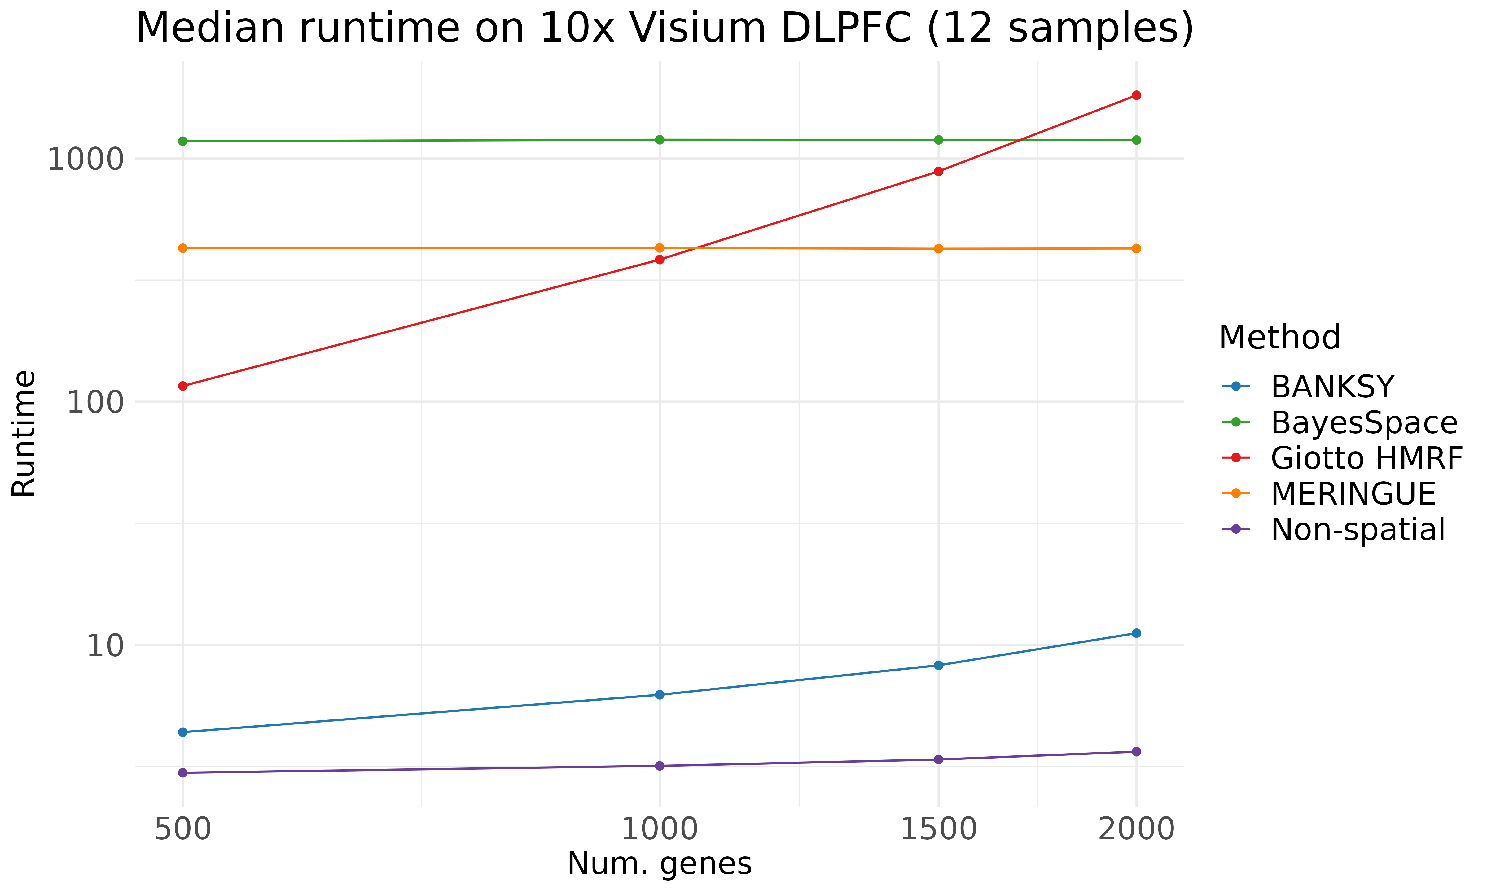

Slide 54
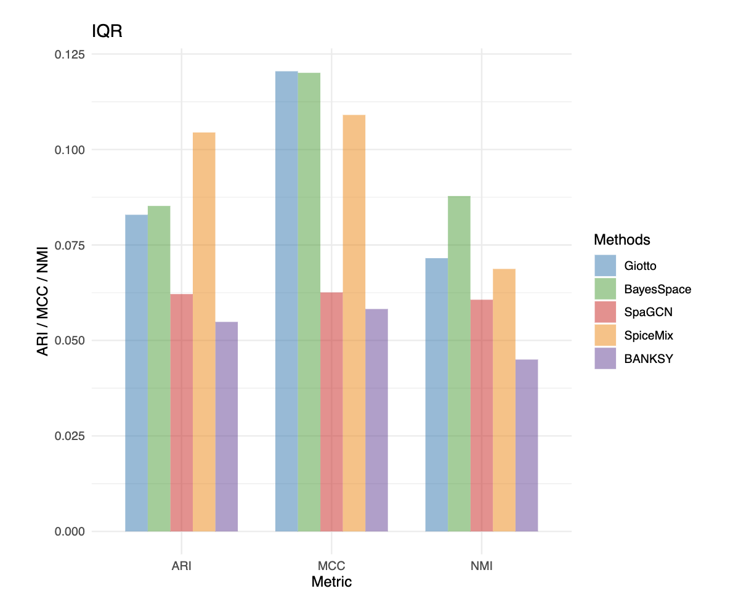
Notes:
Find out what each of these are…

Slide 55
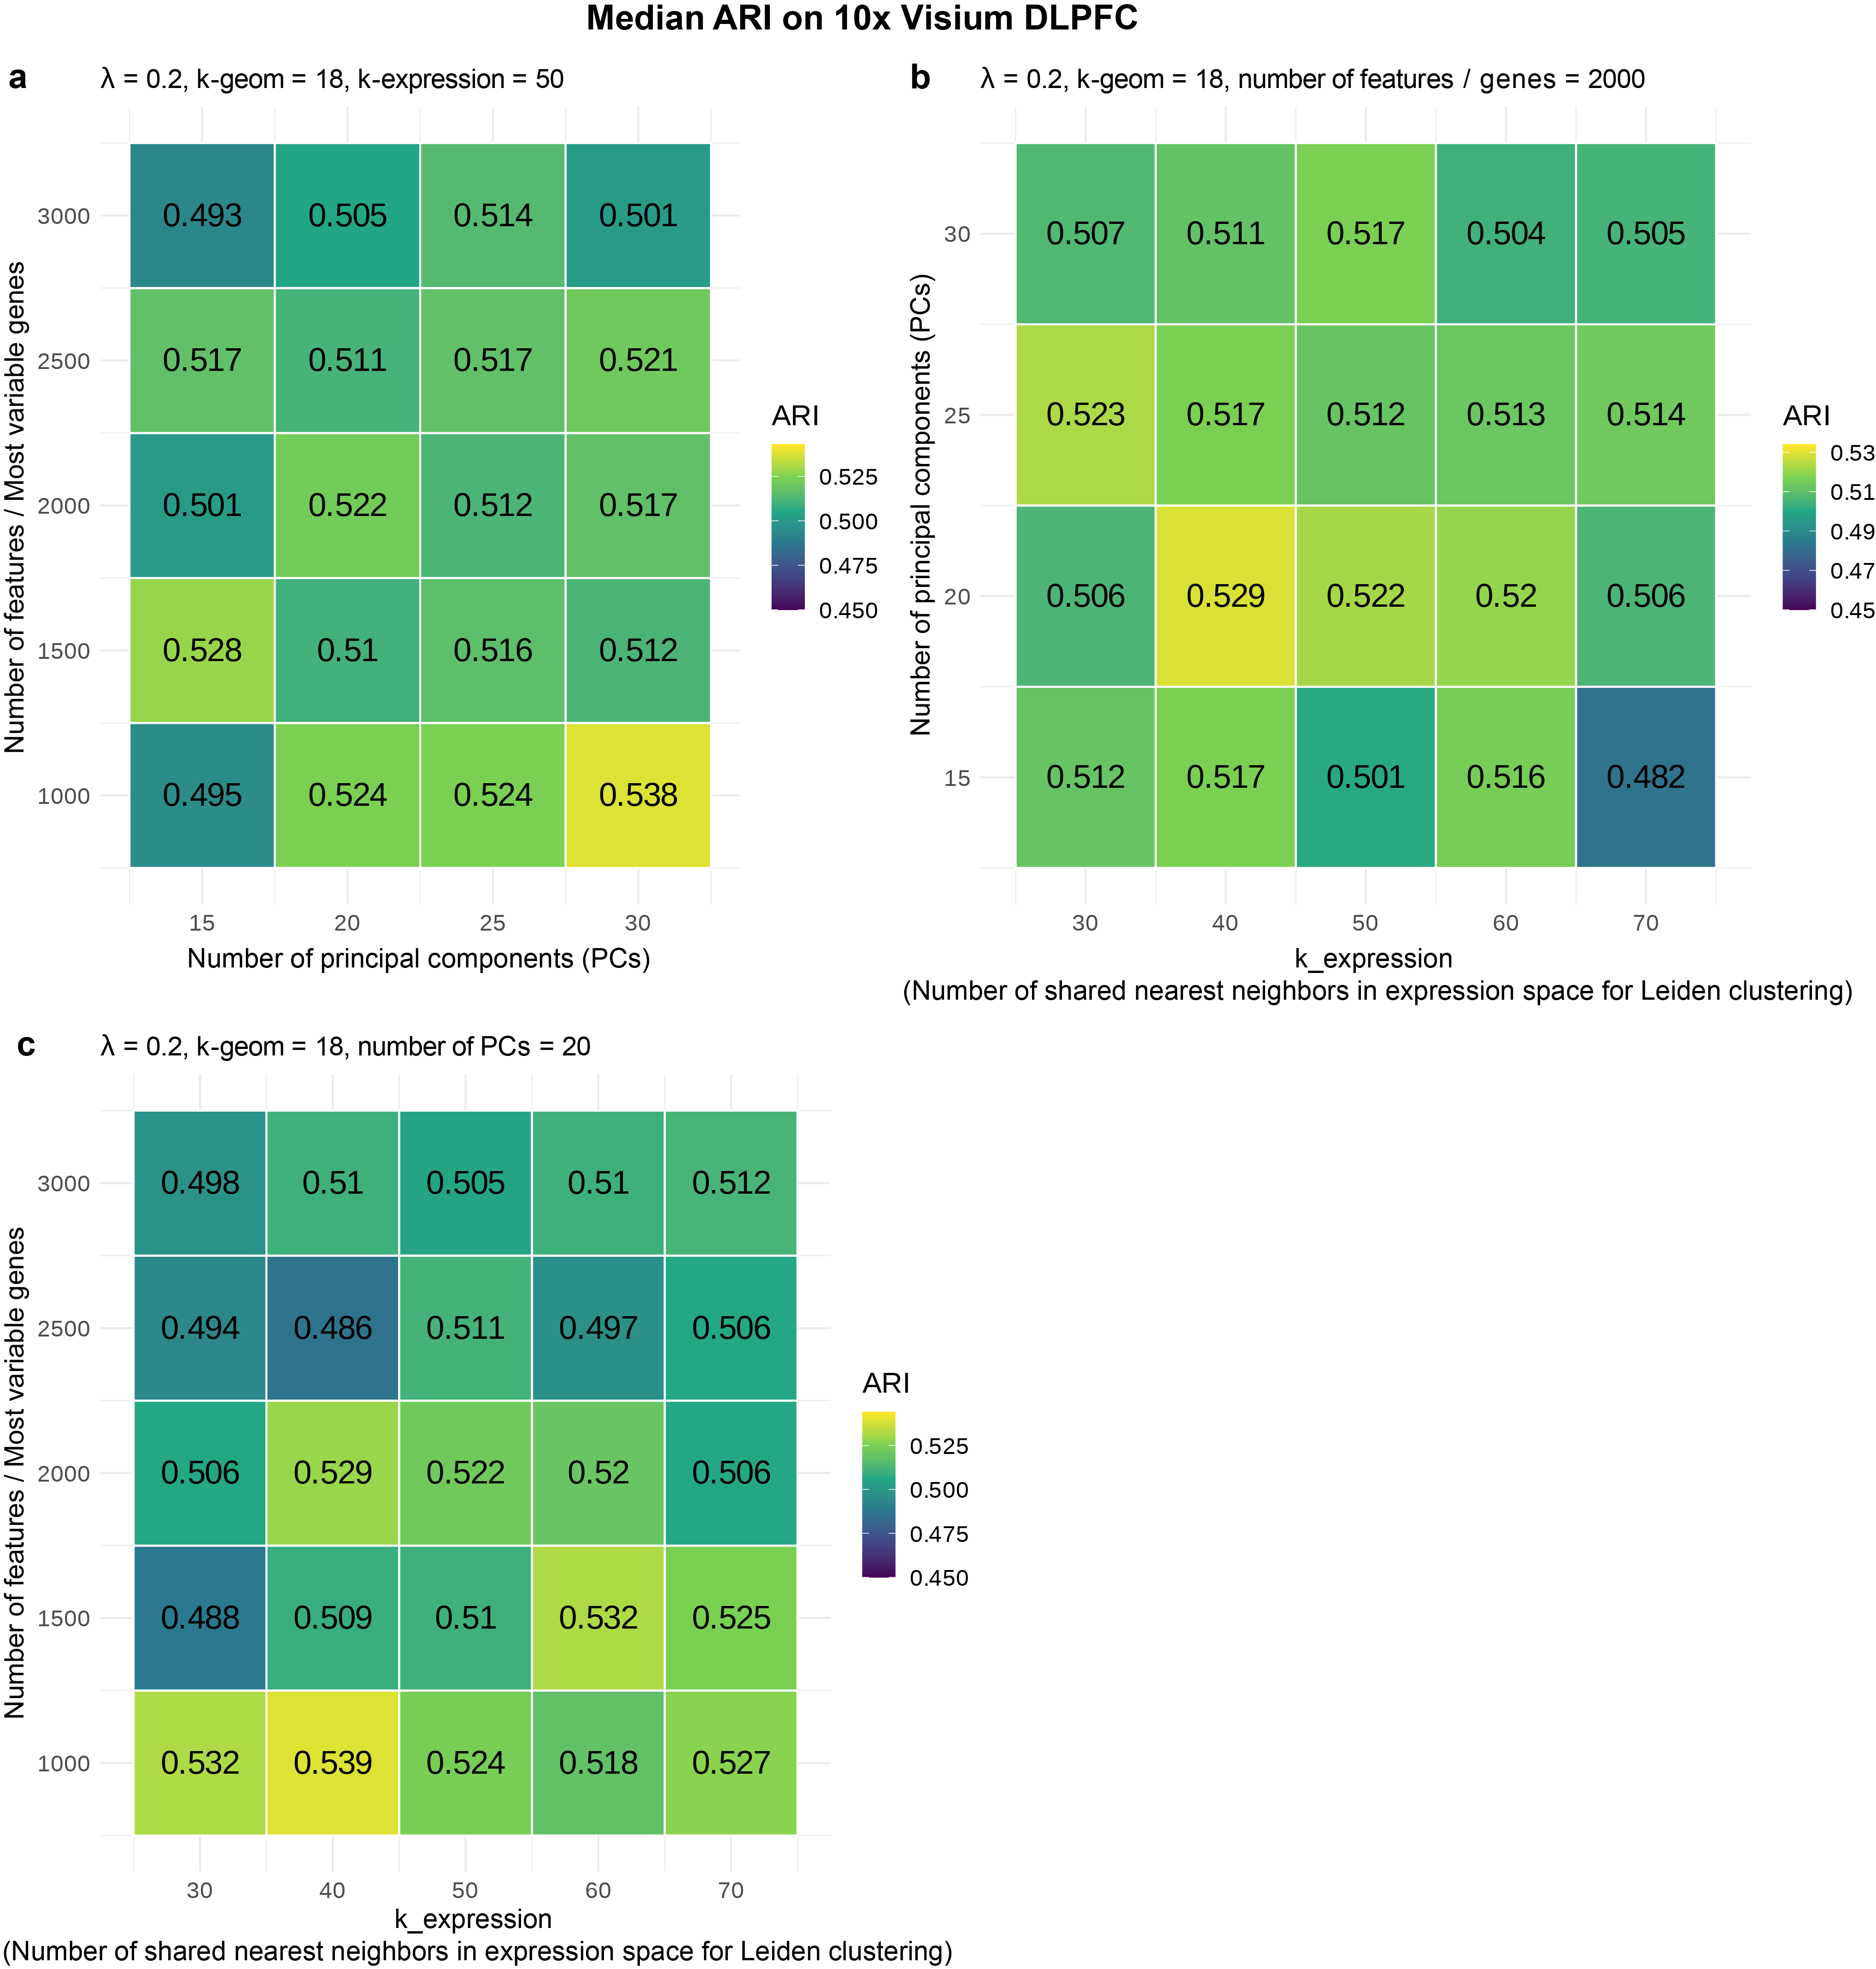
Notes:
Details of how this was done:

Slide 56
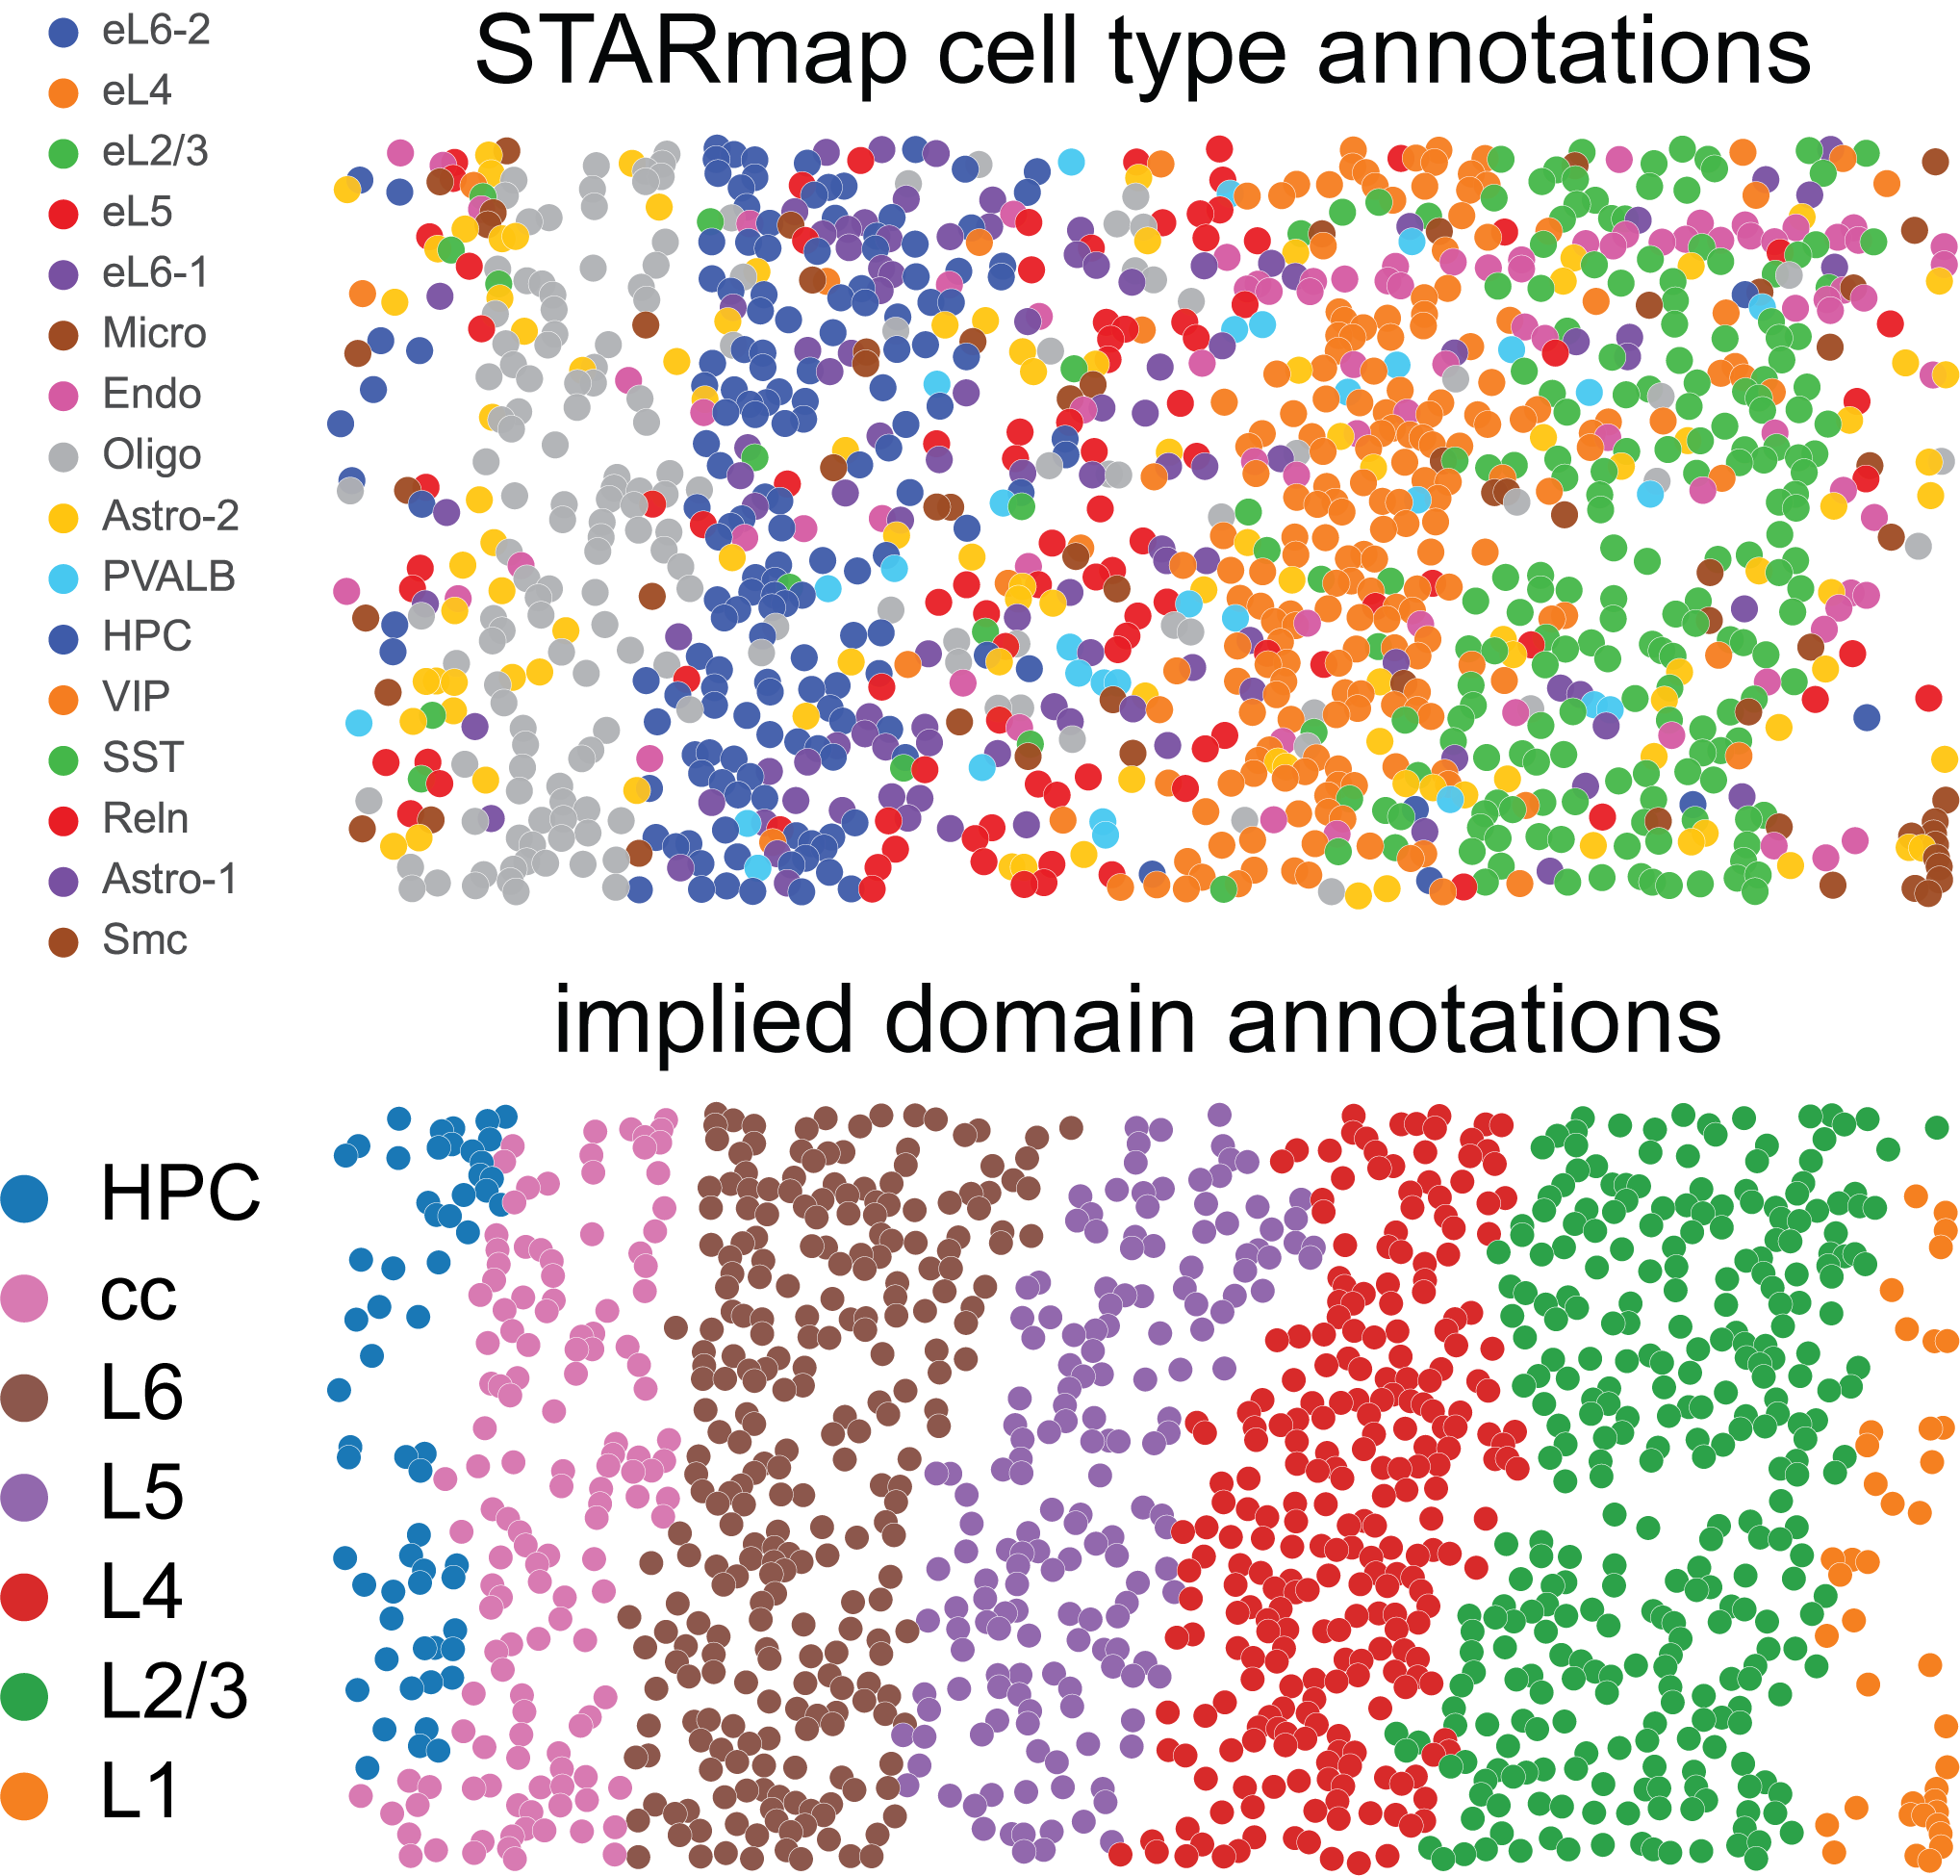

Slide 57
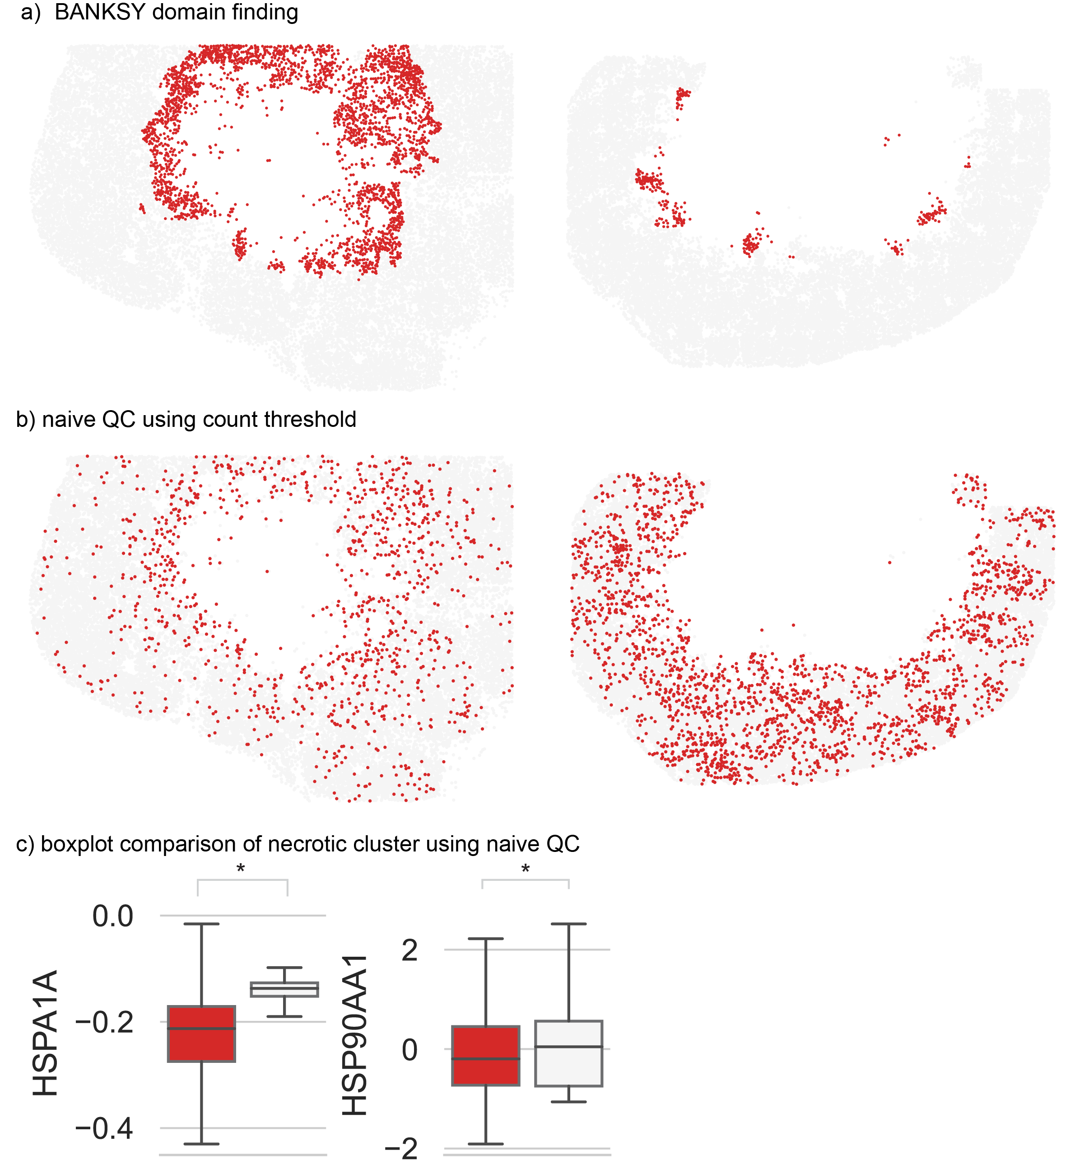

Slide 58
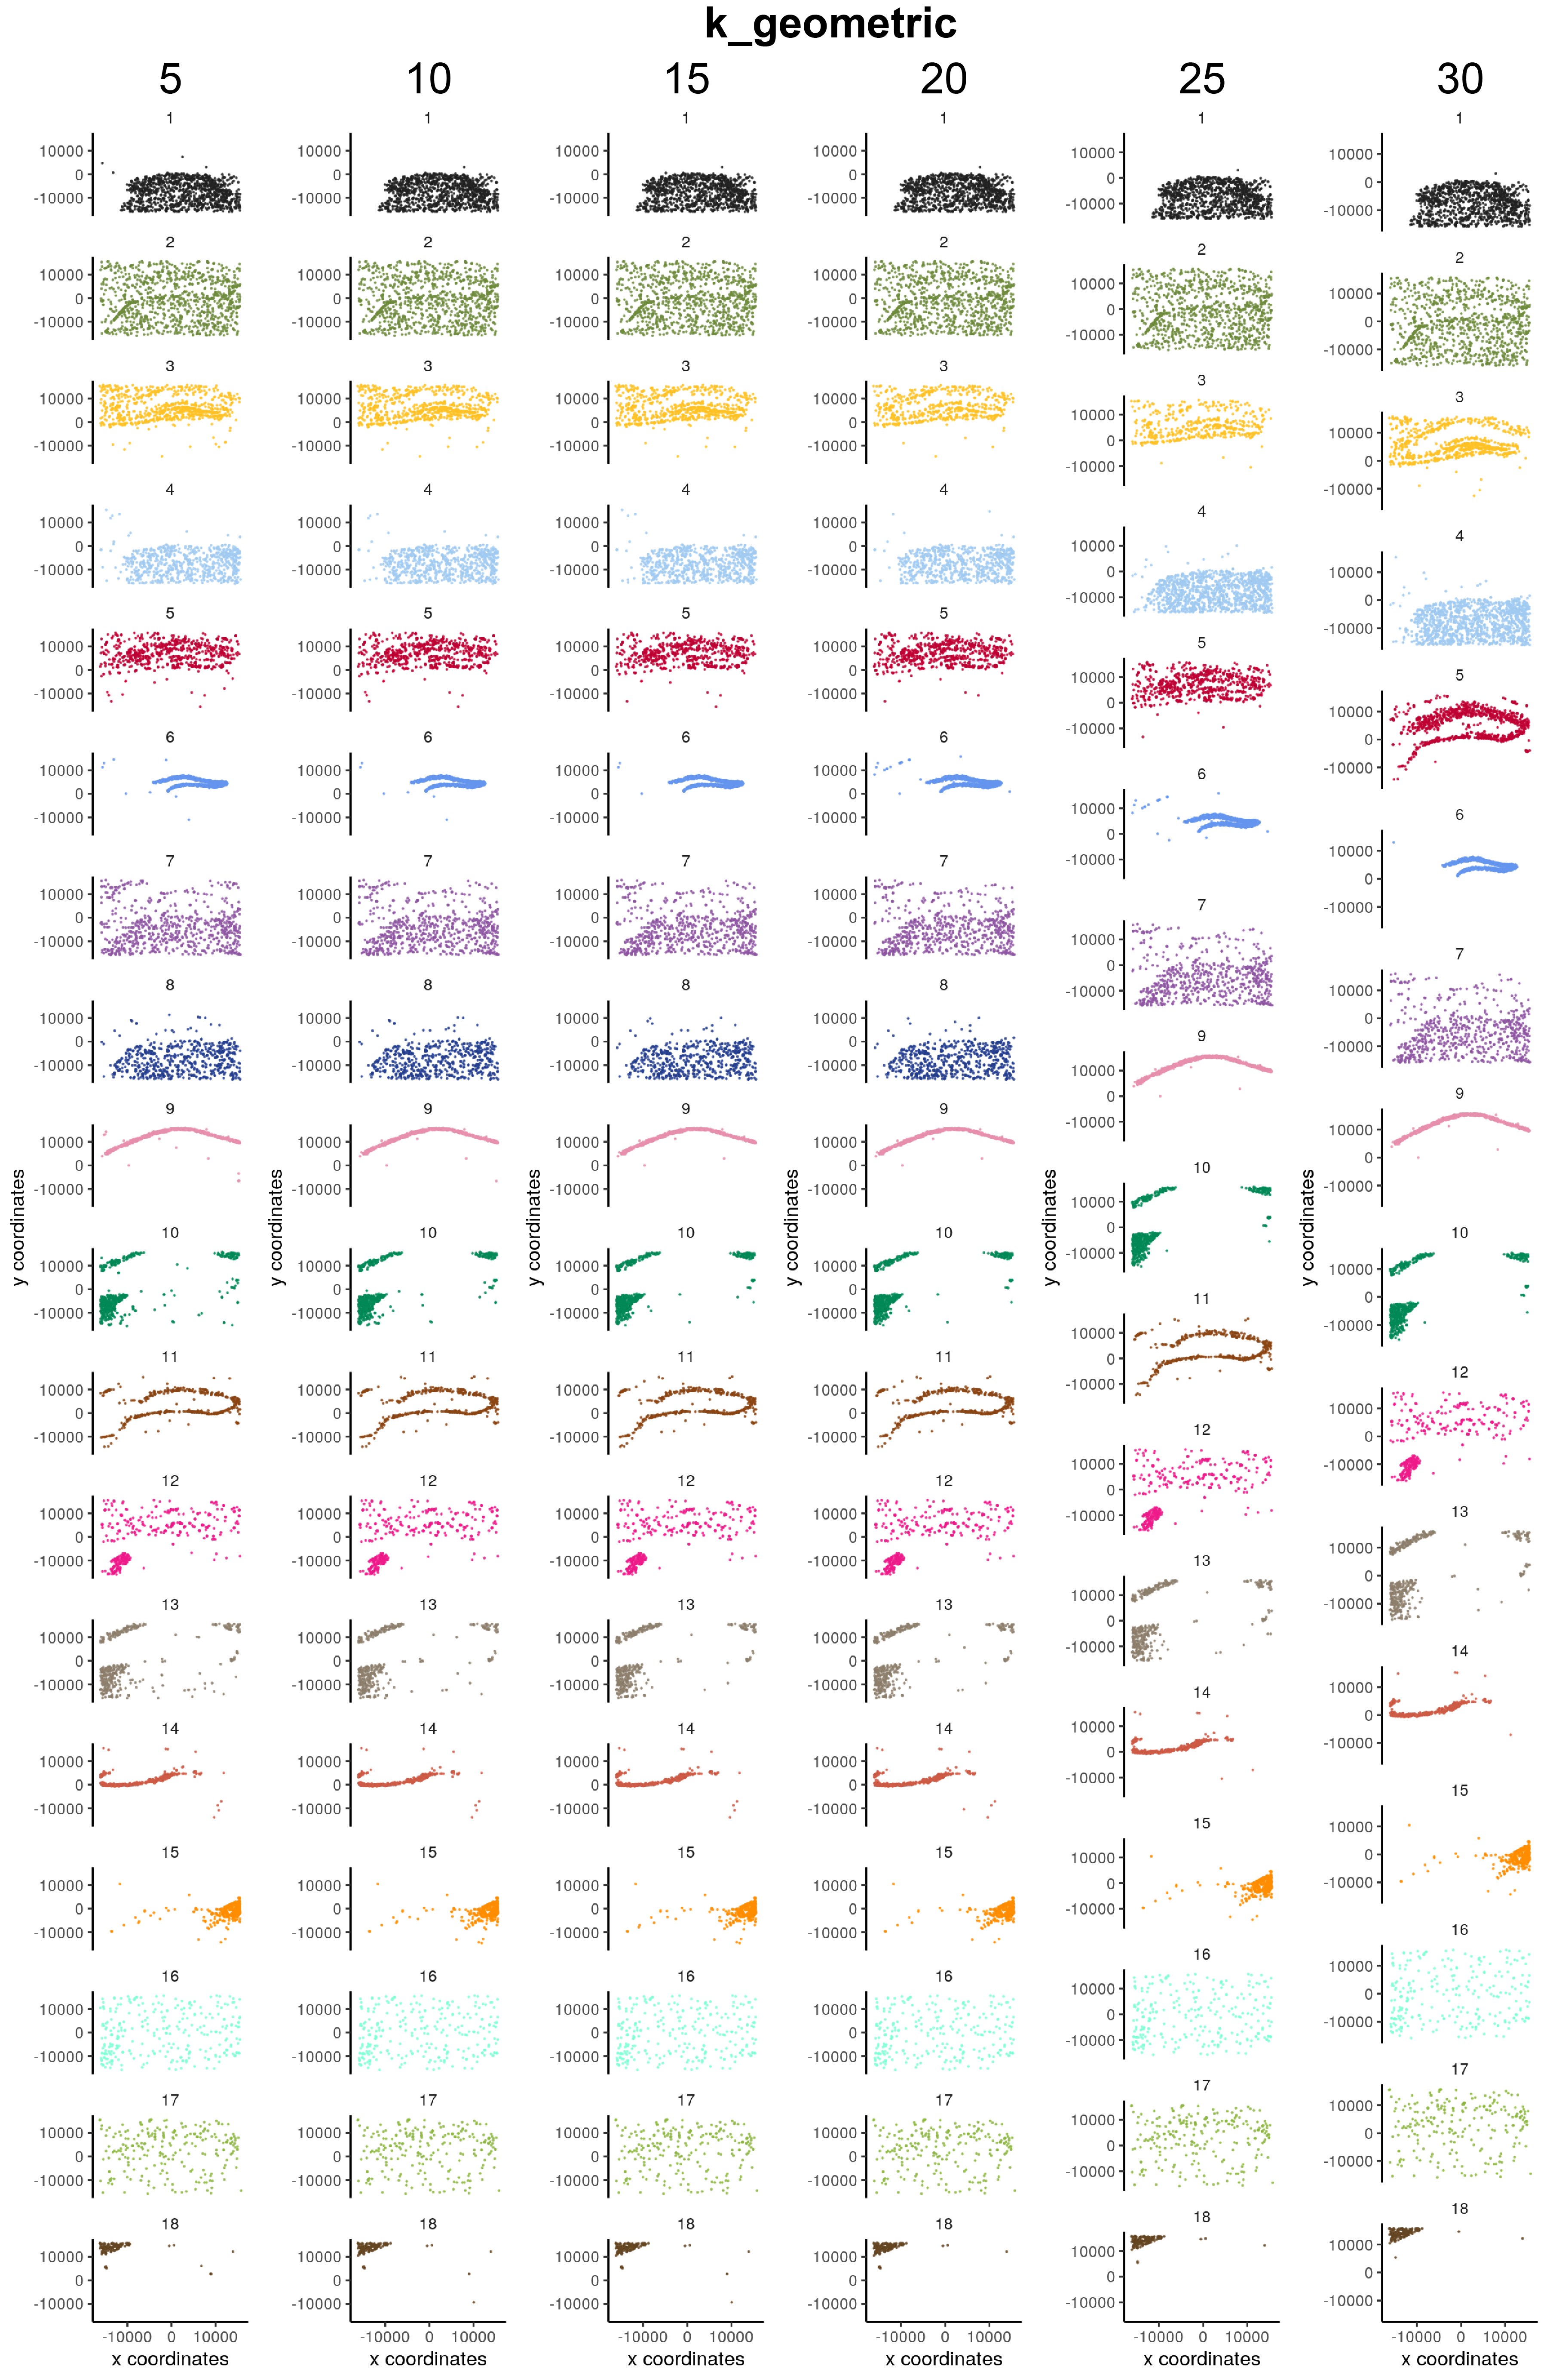
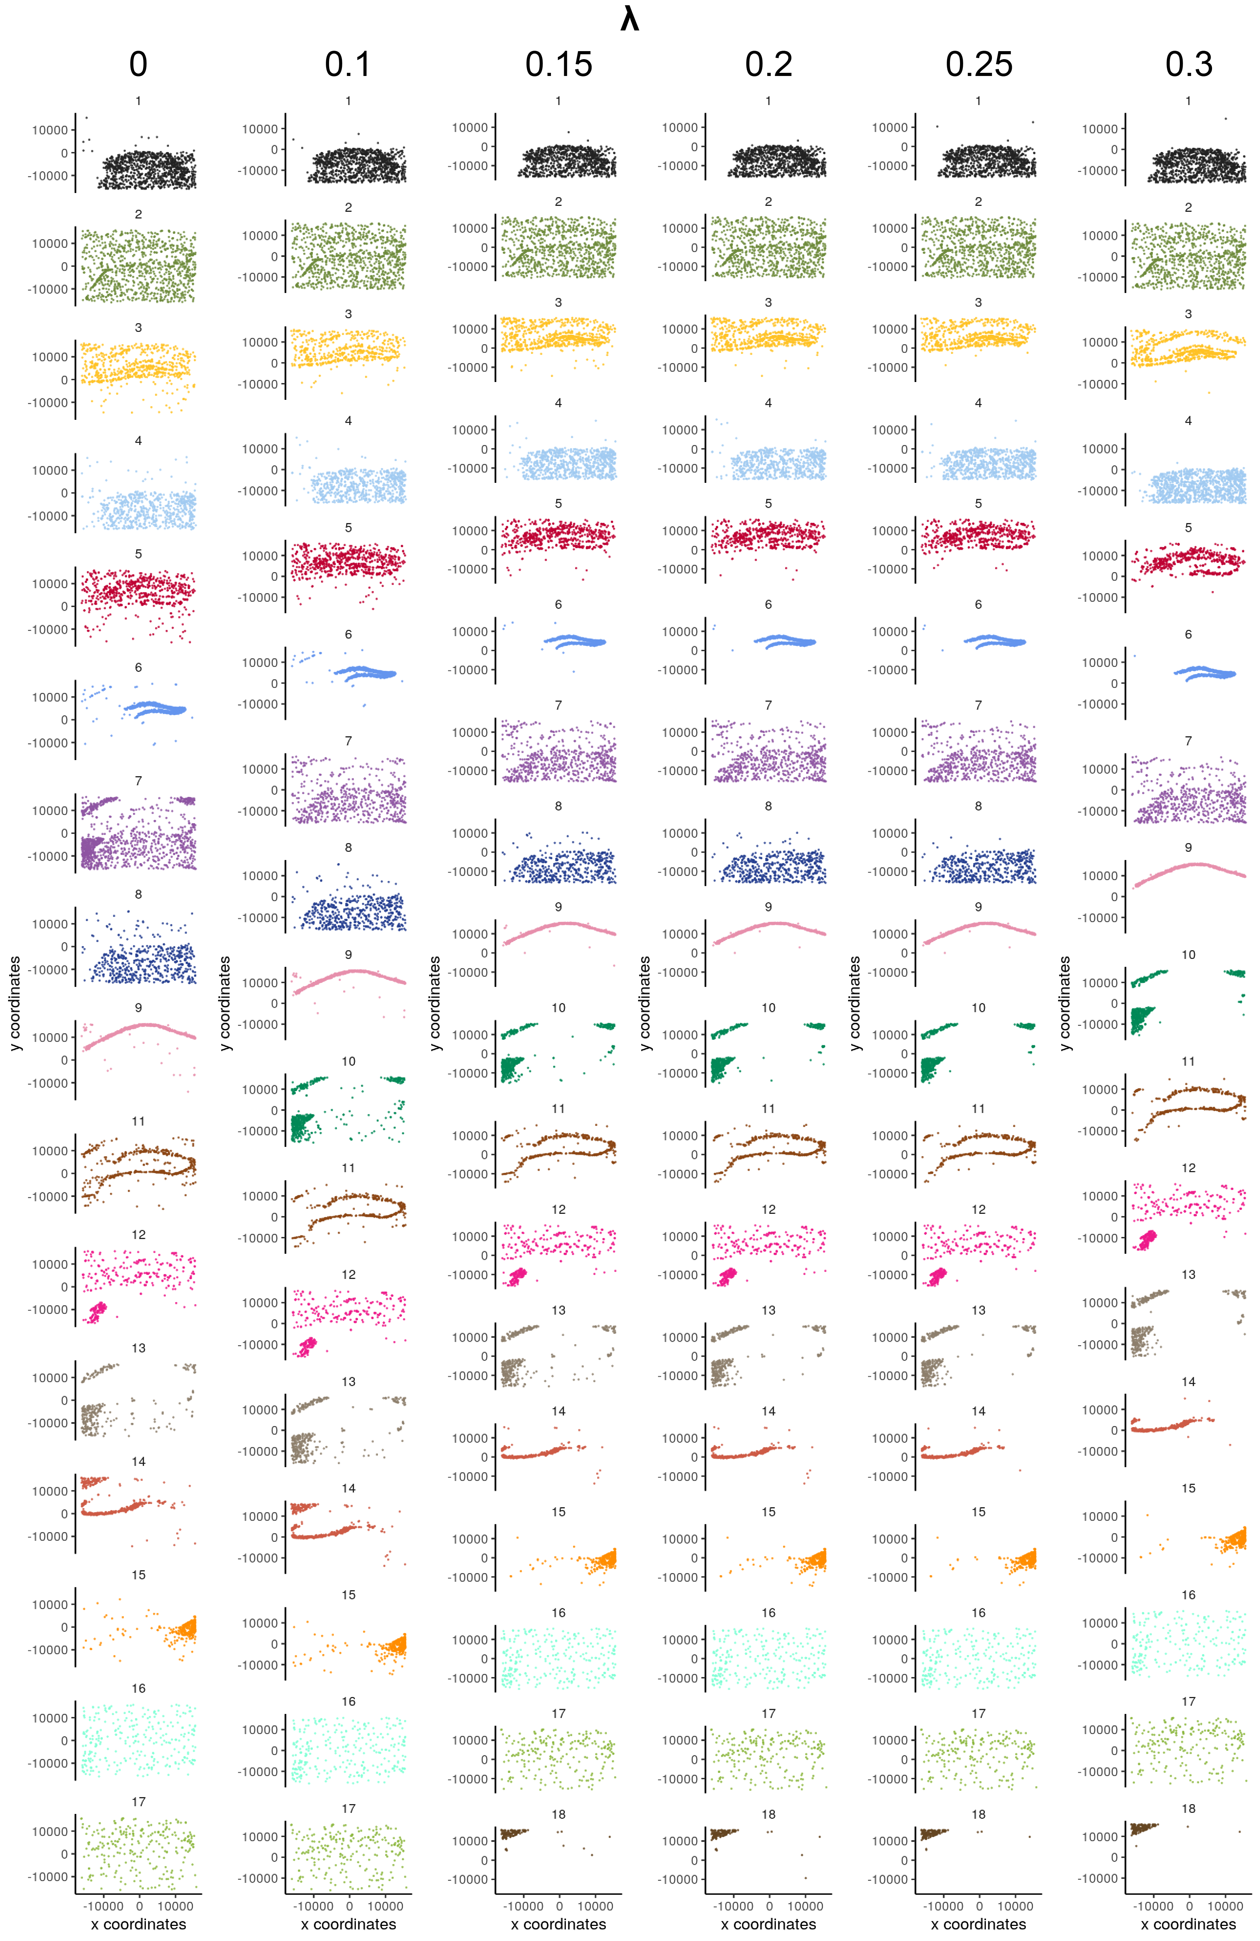

Slide 59
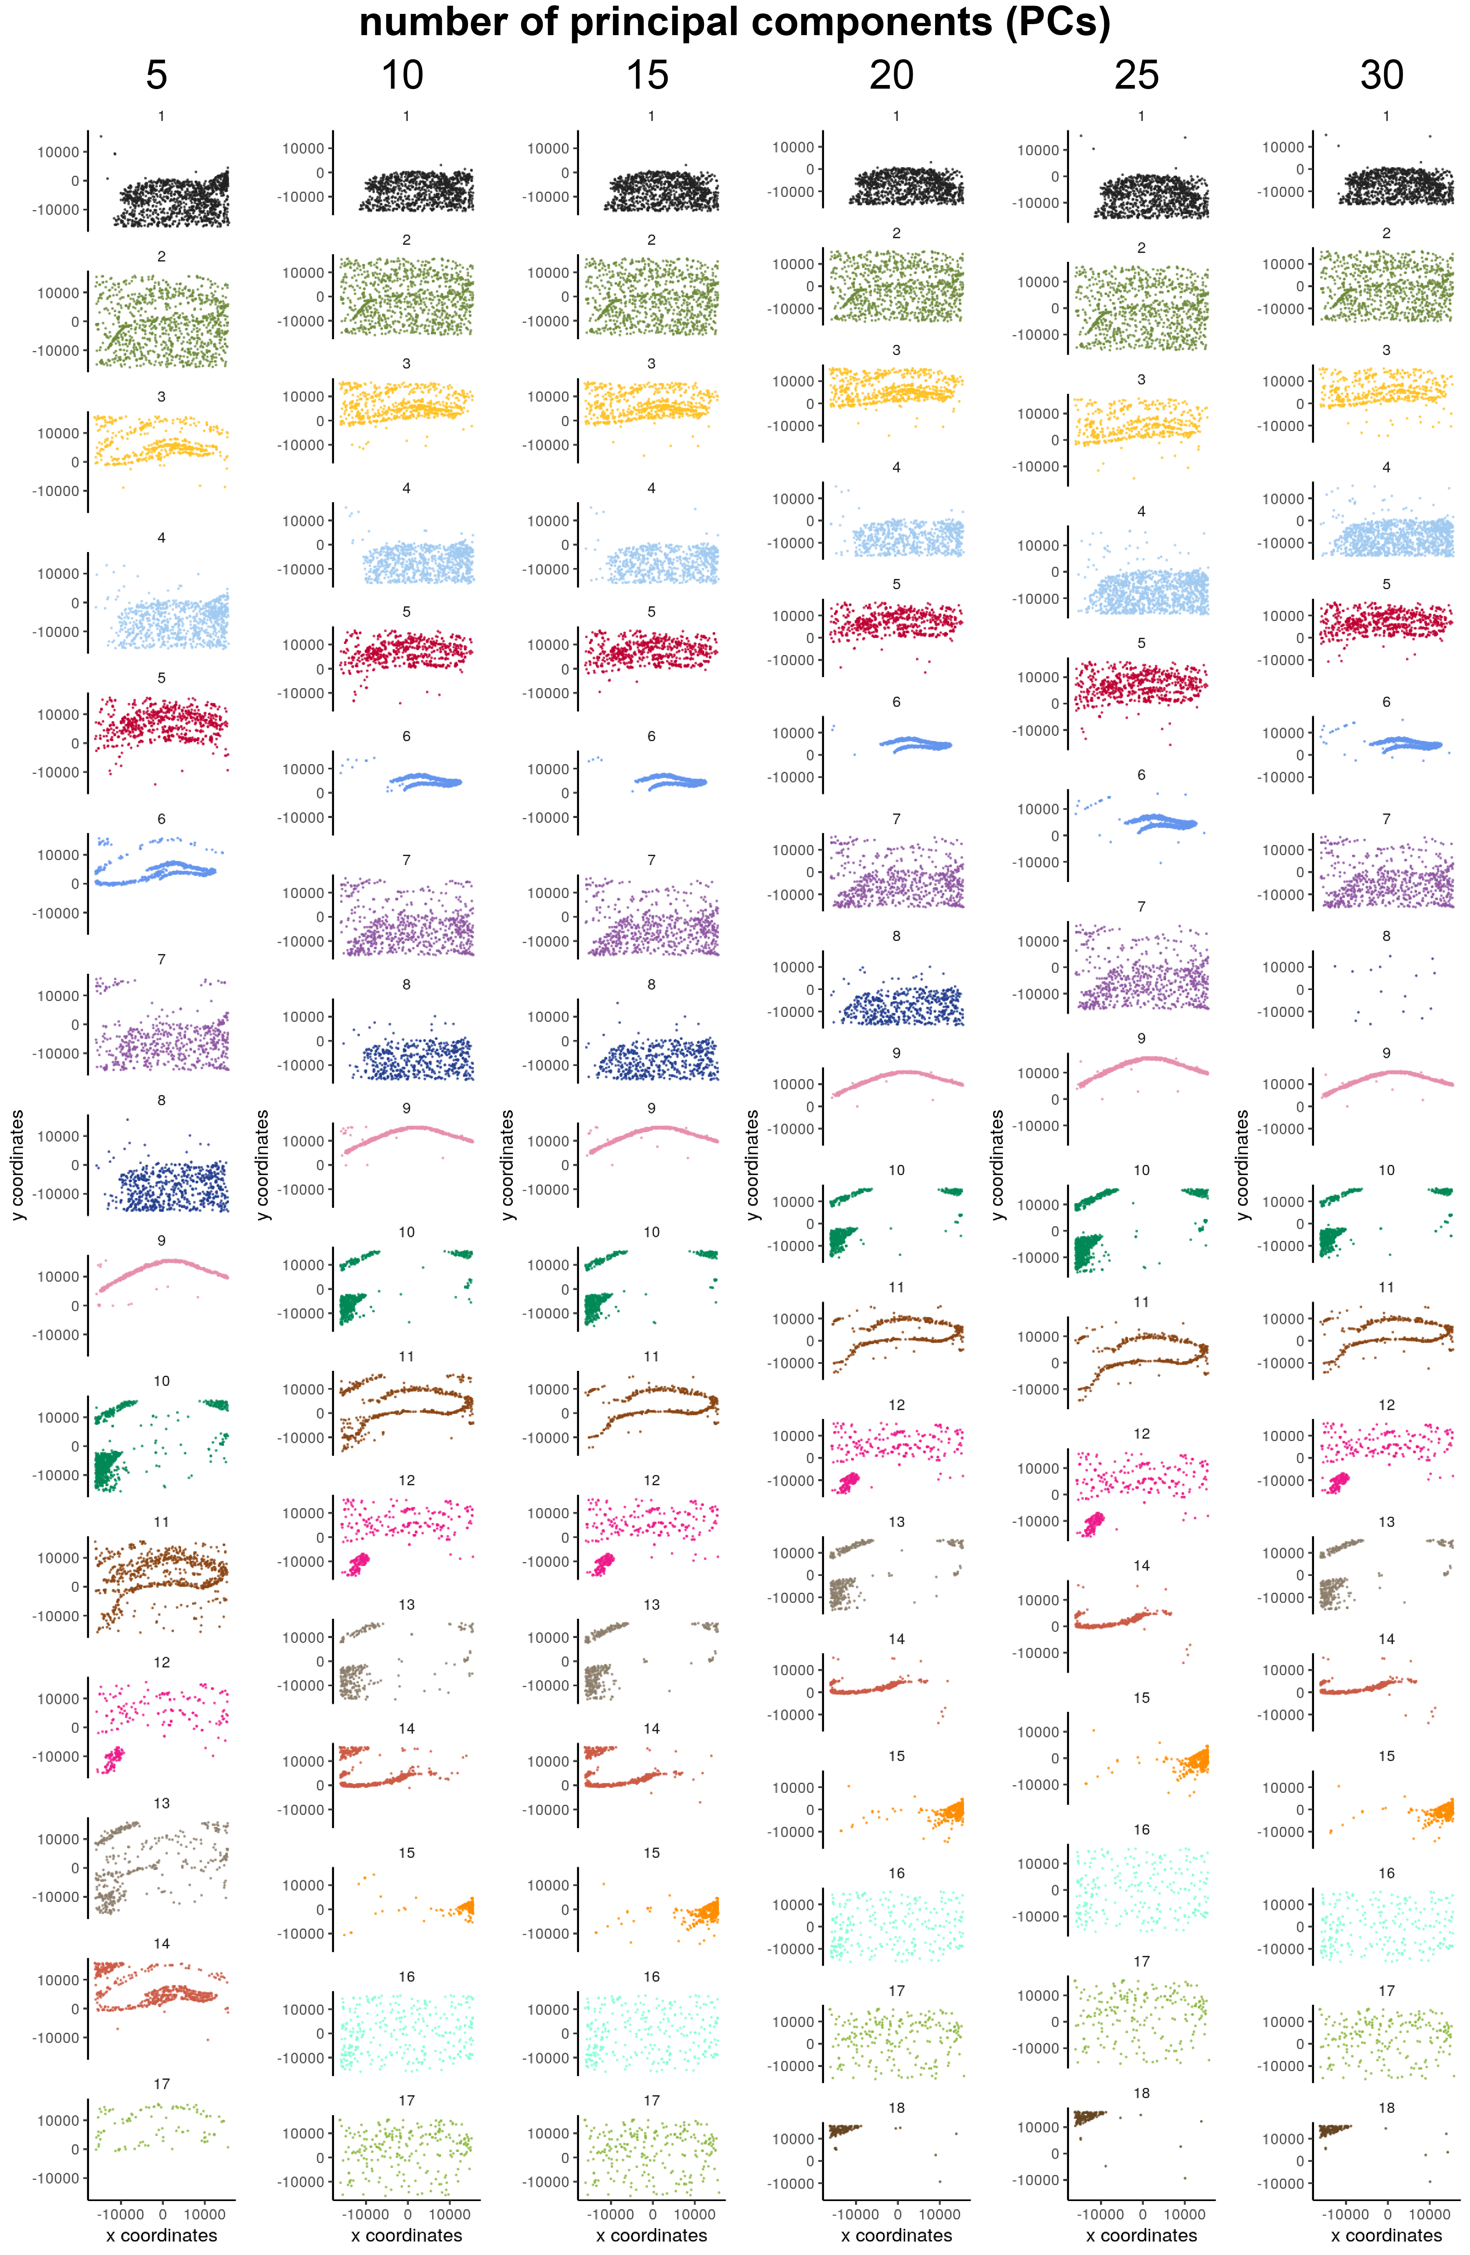
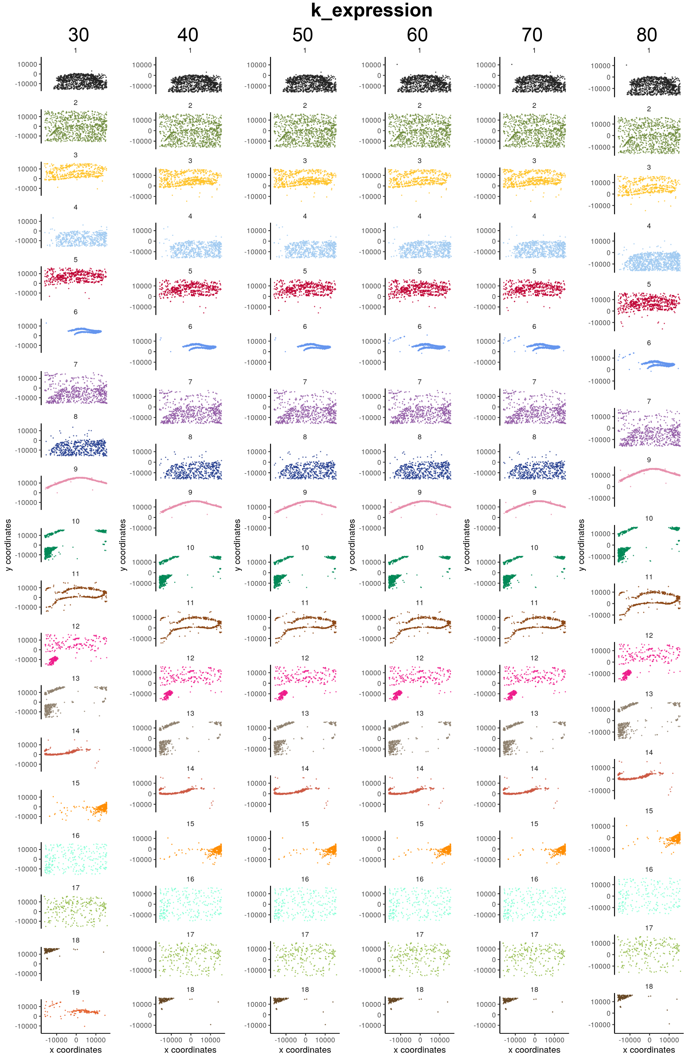

Slide 60
